Slide 1
HIE Playbook to Overcoming Data Challenges during the Pandemic April 21, 2020

Slide 2
Agenda
Welcome
Jennifer Covich Bordenick, CEO, eHealth Initiative
Discussion:
Kim Chaundy, Senior Director, Health Information Exchange & Interoperability at Keystone Health Information Exchange (KeyHIE/Geisinger)
Kevin Conway, Data Enterprise Manager, Nebraska Health Information Initiative (NEHII)
Cody Johansen, Director of Operations at UHIN
Bill Pearch, CIO from HealtheConnect Alaska
Daniel Cidon, Chief Technology Officer, NextGate
Q&A
Jennifer Covich Bordenick, CEO, eHealth Initiative

Slide 3
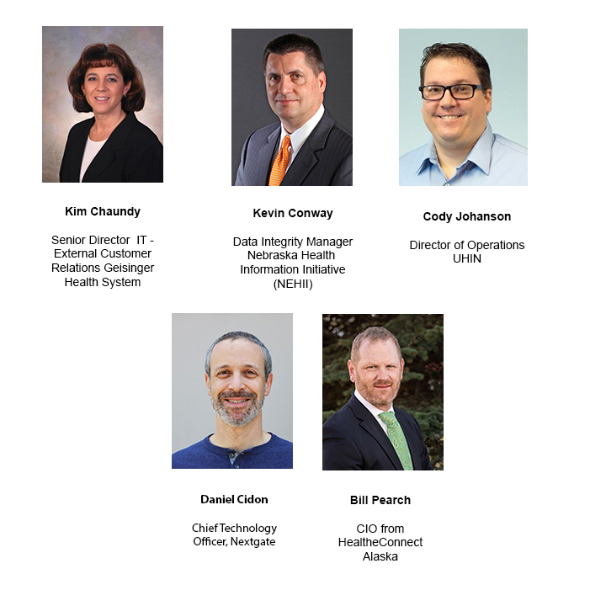
SPEAKERS

Slide 4
Housekeeping
All participants are muted
To ask a question to be answered by speakers:
Use the “Q&A” box found on the bottom of your screen
We will address as many as possible after the presentations
For help with technical difficulties and non-speaker questions:
Use the “chat” box and we will respond as soon as possible
Slides and a recording of today’s presentation will be available for download on eHI’s Resource page: www.ehidc.org/resources
Notes:
Just a little housekeeping
All participants are muted, but we still want to hear from you
If you would like to ask the speakers a question to be answered during the Q&A session, you can use the Q&A box at the bottom of the screen. We will do our best to get through as many questions as we can.
If you need help or have any non-speaker questions, you can use the chat box which is the little bubble found at the bottom of your screen.
Finally, the slides are available now in our resource center. A link to the recording will be added there later this afternoon.
NEXT SLIDE

Slide 5
eHI’s Mission
Convening executives from every stakeholder group in healthcare to discuss, identify and share best practices to transform the delivery of healthcare using technology and innovation.
Notes:
A couple quick points about eHealth Initiative, we’re all about convening executives from across stakeholder groups, bringing together the key players to focus on the critical issues that need to be dealt with to transform healthcare NEXT SLIDE

Slide 6
Current Areas of Focus
Value Based Care
Analytics & SDOH
Interoperability
Privacy & Security
Cost Transparency | Understanding FHIR / APIs / Da Vinci | Protection vs. Access | Non-traditional data sources
Prior Authorization | Policy | HIPAA Part 2 | SDOH & PGHD
 | Workflow | Cybersecurity | EHR Data for Clinical trials
 | Info Blocking | Medical Device Security

Slide 7
eHealth Resource Center www.ehidc.org/resources
eHealth Resource Center available​ with best practices & findings​ identifying and disseminating best practices
Online Resource Center: over 600 new pieces of content, 125 best practices added this year
Notes:
I want to remind everyone about the eHI Resource center located on our website. As a non-profit, we produce a ton of best practices, reports, surveys, and interviews. We also want you to share what you and your organizations are working on. Click the green button in the top right to contribute your own resources.

Slide 8
April 23 – How to Grow Your Practice Through Telehealth with Reimbursement Considerations
April 28 - COVID-19 Impact: Addressing Capacity and Cashflow with Virtual Care
May 5 – Wearables to detect infections (details forthcoming)
May 21- Telepsychiatry (details forthcoming)

Slide 9
This webinar was made possible through the generosity and support of

Slide 10
The hie playbook to
Overcoming data
Challenges during
The pandemic
Notes:
HIE is serving as a critical information backbone to help coordinate a response to this crisis statewide.

Slide 11
PANEL DISCUSSION
Tell us about your respective HIE and how you have pivoted over the last month in response to the pandemic?
nextgate.com
Q&A
nextgate.com
Notes:
Requests from state governments and requests from department of health

Slide 12
PANEL DISCUSSION
What is your HIE doing to support or enrich COVID-19 data collection, reporting and analysis?
Q&A
nextgate.com
Notes:
Forecast hotspots/community spread
data collection for modeling
Real-time access to laboratory testing
Insights into COVID-19 hospitalizations
Forecasting
Lab data
retroactively enriching test results, positive and negative, with race and ethnicity
Coding

Slide 13
PANEL DISCUSSION
What have been the biggest barriers to COVID-19 data collection? How have you overcome them?
Q&A
nextgate.com
Notes:
For example, incorporating data from those sources/participants that are not a part of the network
Turf guarding – some of these sources have never worked together before
new and unfamiliar workflows

Slide 14
PANEL DISCUSSION
How receptive have your partners and the tech community been in supporting your COVID-19 data projects?
Q&A
nextgate.com

Slide 15
PANEL DISCUSSION
The pandemic has highlighted the importance of interoperability.
Discuss the advantages HIEs have as a centralized piece of infrastructure to facilitate accurate reporting as well as a coordinated response to this crisis
Q&A
nextgate.com
Notes:
Hoping someone can mention the importance of HIE’s role in managing patient identification
We know there have been issues with lab data (missing demographics)

Slide 16
PANEL DISCUSSION
Talk about the importance of data quality and identity resolution for tracking and reporting efforts.
Q&A
nextgate.com
Notes:
Perhaps this can be directed at Dan...
identity resolution
accurate patient demographics

Slide 17
PANEL DISCUSSION
What can ONC and other federal agencies do to help advance emergency HIE response efforts?
Q&A
nextgate.com
Notes:
HIEs must be a part of the achieve national interoperability –for the benefit of patients/citizens, public health and the healthcare system
HIEs are key assets to be supported, managed, and put to work
NPID discussion
– HIE as critical national infrastructure, source of funding needed
– Roles in Public Health, Disaster Response, Clinical Care, Value Based Payment Models
_ HIE is a public health infrastructure
labs are faxing data – to eliminate and ensure identity is matched to lab data.
URGE ONC help with lab info blocking rule? amendments to share data via public health
HIPPA related to COVID-19

Slide 18
PANEL DISCUSSION
What can be done to help lead the recovery effort once society reopens and a second potential wave hits?
Q&A
nextgate.com
Notes:
Social Needs Screening? Symptom Screener ?

Slide 19
QUESTION & ANSWER
KIM CHAUNDY
KeyHIE
DAN CIDON
NextGate
KEVIN CONWAY
NEHII
CODY JOHANSEN
UHIN
BILL PEARCH
healtheConnect Alaska
nextgate.com

Slide 20
Thank You
For more information visit:
www.nextgate.com
Or send questions to:
info@nextgate.com
dan.cidon@nextgate.com
3579 E FOOTHILL BLVD, SUITE 587, PASADENA, CA 91107 | (626) 376-4100 | NEXTGATE.COM | INFO@NEXTGATE.COM

Slide 21
This webinar was made possible through the generosity and support of

