Slide 1
eHealth Initiative
Data Analytics Work Group
September 3, 2015
2:00 p.m. EDT

Slide 2
Reminder
Please mute your line when not speaking
(* 6 to mute, *7 to unmute)
This call is being recorded

Slide 3
Data Analytics Co-Chairs
Chris Leggett
  Director, U.S. Public Policy
  GlaxoSmithKline
Steven E. Waldren, M.D., M.S.
  Director, Alliance for eHealth Innovation
  American Academy of Family Physicians

Slide 4
Agenda
Welcome and Overview of Agenda
Introduction of Speaker & Presentation
Data Analytics eHI Community
Workgroup goals, process and timeline
Next Steps

Slide 5

www.mdanderson.org • www.mdanderson.org/ask
1-877-MDA-6789

Slide 6

Our Mission
To eliminate cancer in Texas, the nation and the world through outstanding programs that integrate patient care, research and prevention, and through education for undergraduate and graduate students, trainees, professionals, employees and
the public.

Slide 7
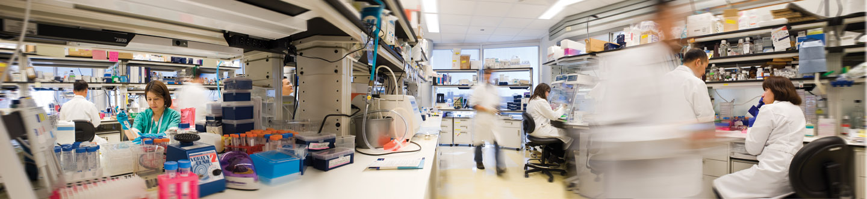
Our Vision
We shall be the premier cancer center in the world, based on the excellence of our people, our research-driven patient care and our science.

Slide 8


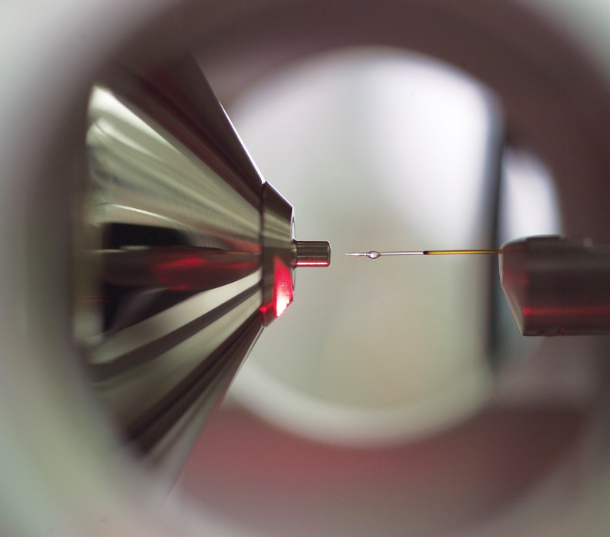
Core Values
Caring • Integrity • Discovery

Slide 9

Patient Care

Slide 10

Patient Care • FY 2014
Treated more than 127,000 people.
Almost 8,000 participants were enrolled in clinical trials exploring innovative treatments. It’s the nation’s largest cancer clinical
trial program.

Slide 11
Patient Care • FY 2014
Hospital admissions | 27,761
Average number of inpatient beds | 654
Outpatient clinic visits, treatments and procedures | 1,363,008
Pathology/laboratory medicine procedures | 12,005,766
Diagnostic imaging procedures | 523,297
Surgery hours | 69,506
Active clinical research protocols | 1,101

Slide 12
Core systems
Big Data
Institutional analytics
User experience
Cognitive computing
Major Initiatives

Slide 13



Big Data for Analytics & Cognitive Computing
Systems of Insights
Systems of Reporting
Facebook
U.S. Census
UPS
Cognitive Claims
Systems of Record
EPM
Center for Disease Control
Kronos
Web Analytics
Peoplesoft
Point of Sale
Enterprise Business
Yelp!
The Weather Channel
Facilities
Parking Garages
Hyperion
oracle.com
UTPD
Rotary House
Smart View
LinkedIN
Twitter
Volunteer Services
MyHR
Google
Oracle Business Intelligence
Youtube
Reuters
Cognitive
Cerner
Big Data
Clinic Station
Clinical
Patient Concierge
Epic
Lab
GE IDX
CARE
Pharmacy
Hyperion Interactive Reporting
Cohort Explorer
FIRE
Medical Devices
Wayfinding
LCDR
Gemini
Research
Crystal
Building Controls
IPCT
Business Objects
Campus Video
Melcore
EIW
Medical Equipment
Cognitive Help Desk
Real-time Location Service

Slide 14
Big Data for Analytics & Cognitive Computing
Systems of Insights
Systems of Reporting
Facebook
U.S. Census
UPS
Cognitive Claims
Systems of Record
EPM
Center for Disease Control
Kronos
Web Analytics
Peoplesoft
Point of Sale
Enterprise Business
Yelp!
The Weather Channel
Facilities
Parking Garages
Hyperion
oracle.com
UTPD
Rotary House
Smart View
LinkedIN
Twitter
Volunteer Services
MyHR
Google
Oracle Business Intelligence
Youtube
Reuters
Cognitive
Cerner
Big Data
Clinic Station
Clinical
Patient Concierge
Epic
Lab
GE IDX
CARE
Pharmacy
Hyperion Interactive Reporting
Cohort Explorer
FIRE
Medical Devices
Wayfinding
LCDR
Gemini
Research
Crystal
Building Controls
IPCT
Business Objects
Campus Video
Melcore
EIW
Medical Equipment
Cognitive Help Desk
Real-time Location Service

Slide 15
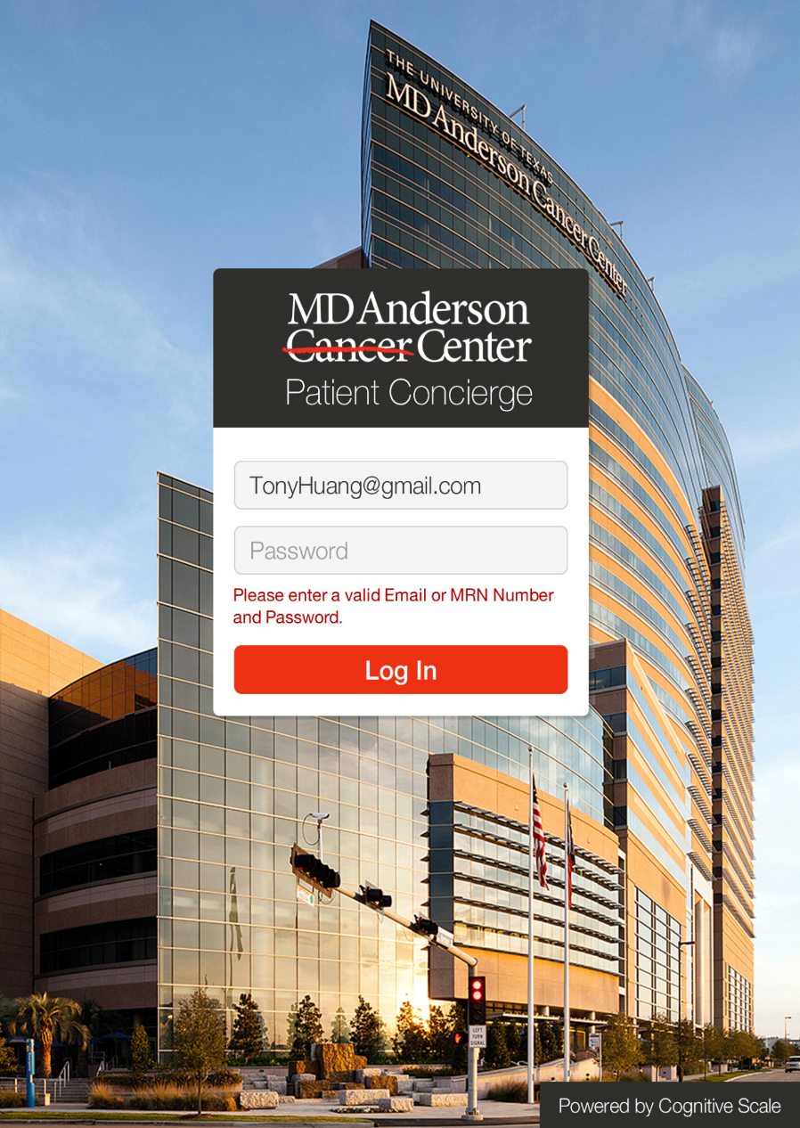
Patient Concierge

Slide 16
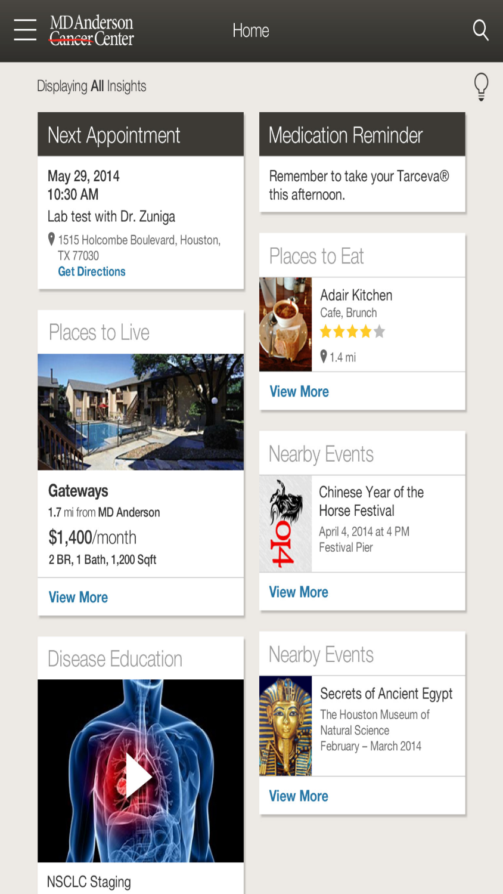

Slide 17
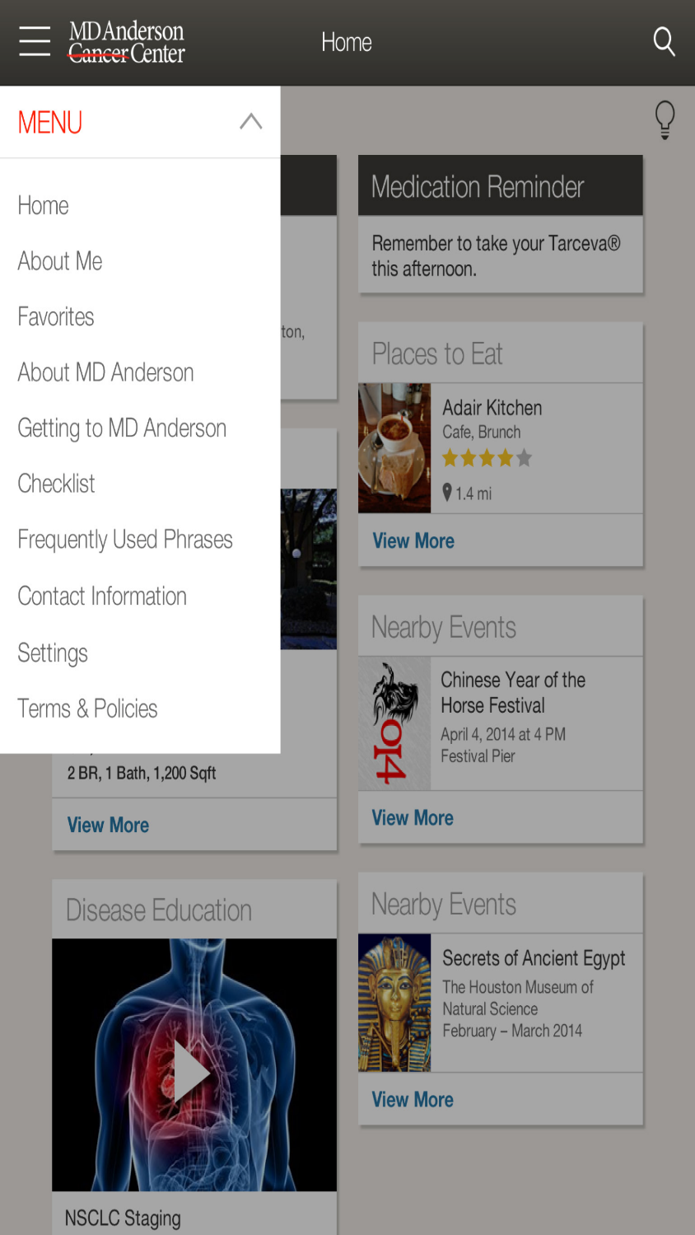

Slide 18
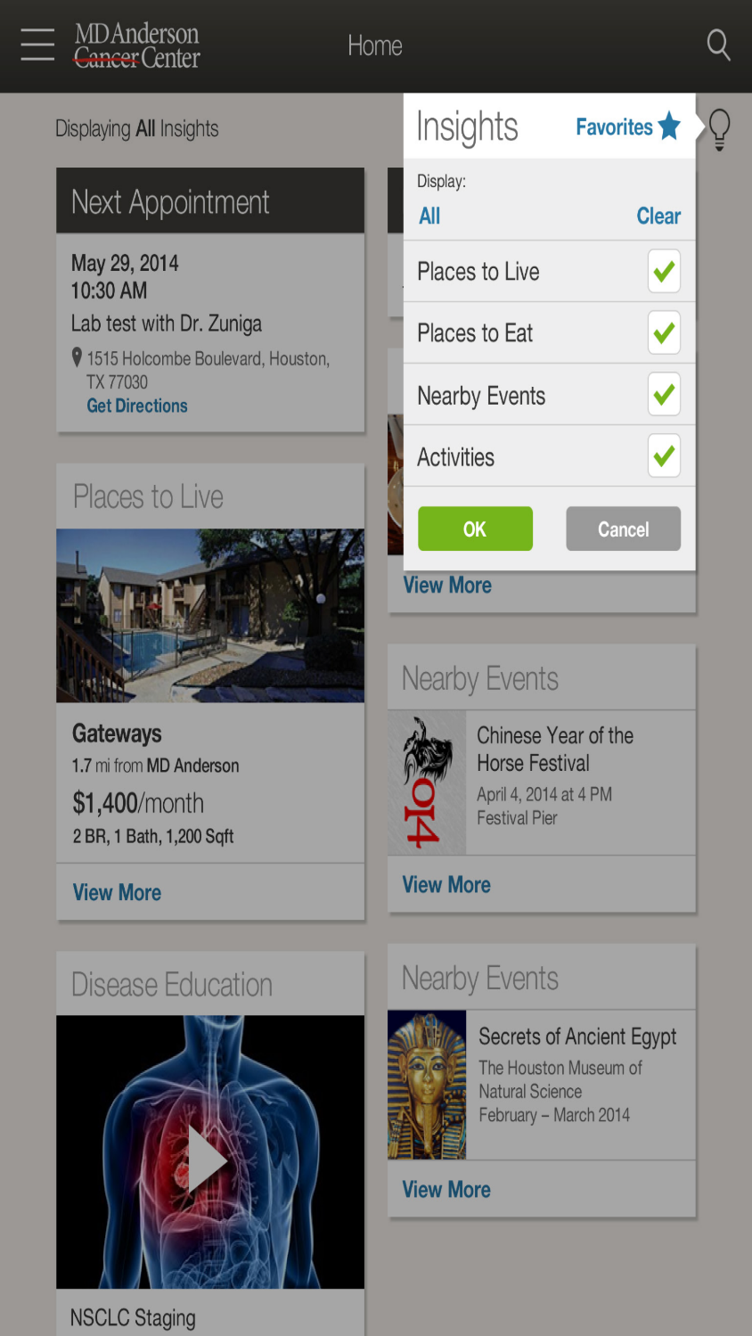

Slide 19
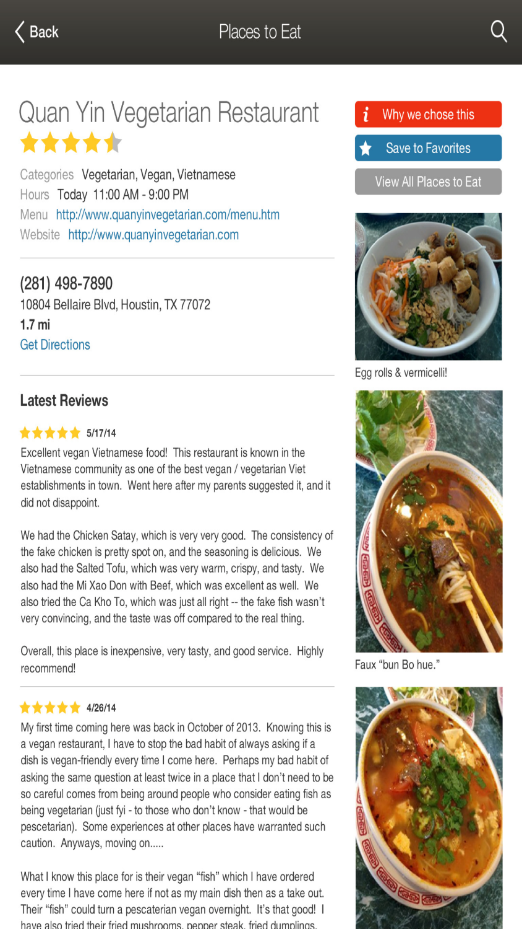

Slide 20
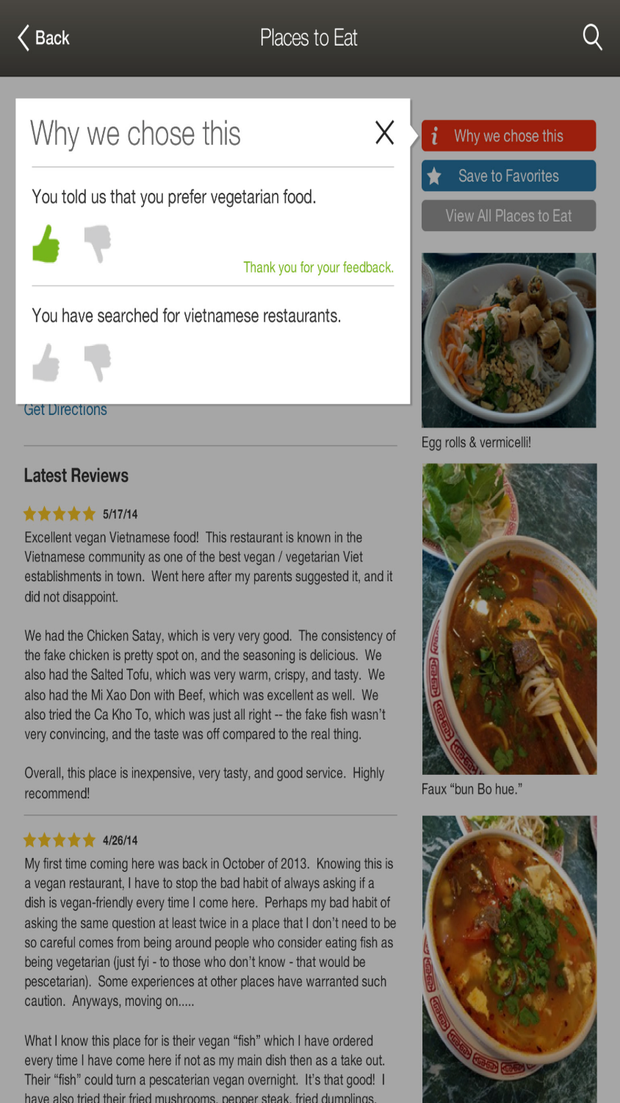

Slide 21
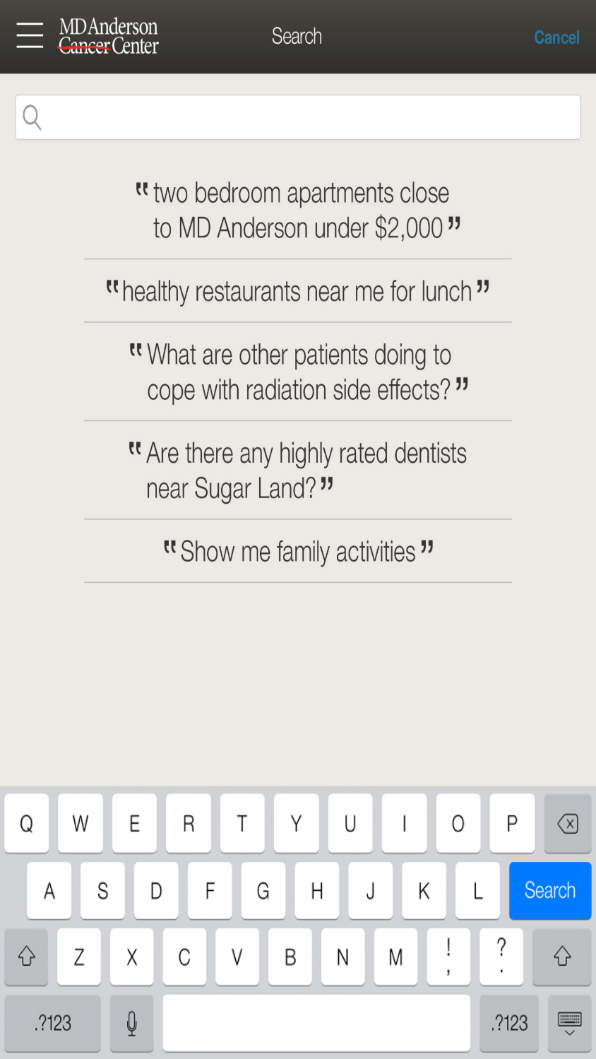

Slide 22
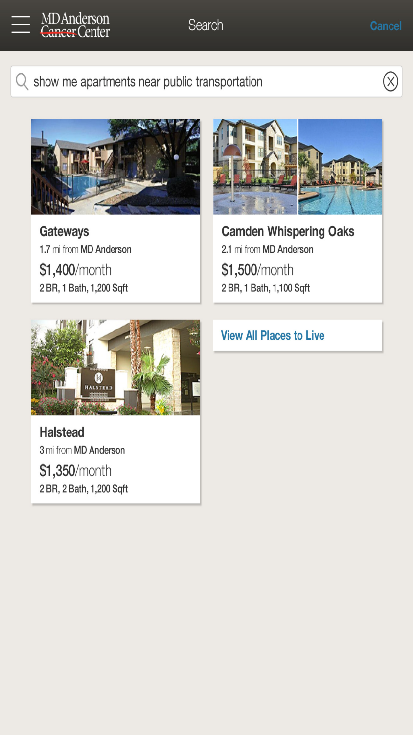

Slide 23
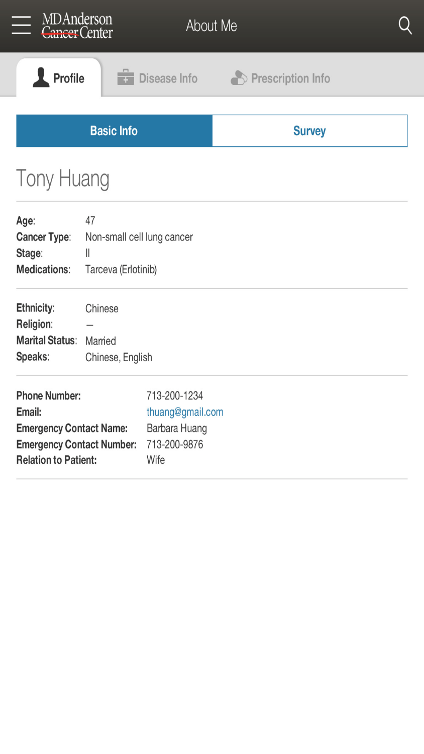

Slide 24
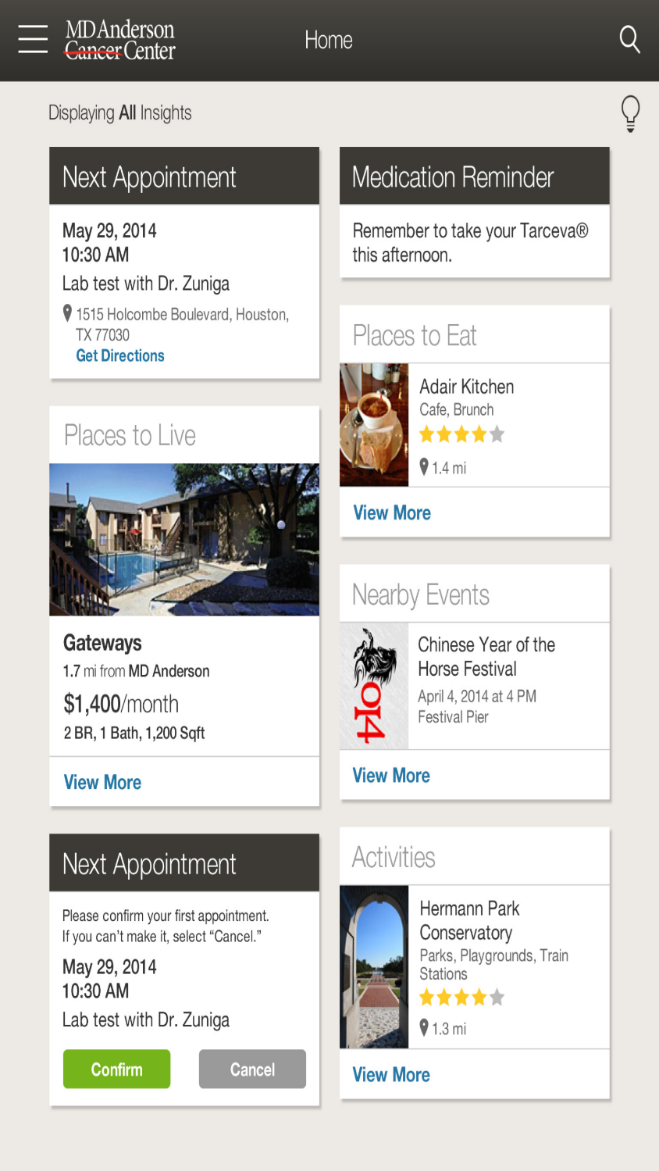

Slide 25
Cognitive Claims

Slide 26
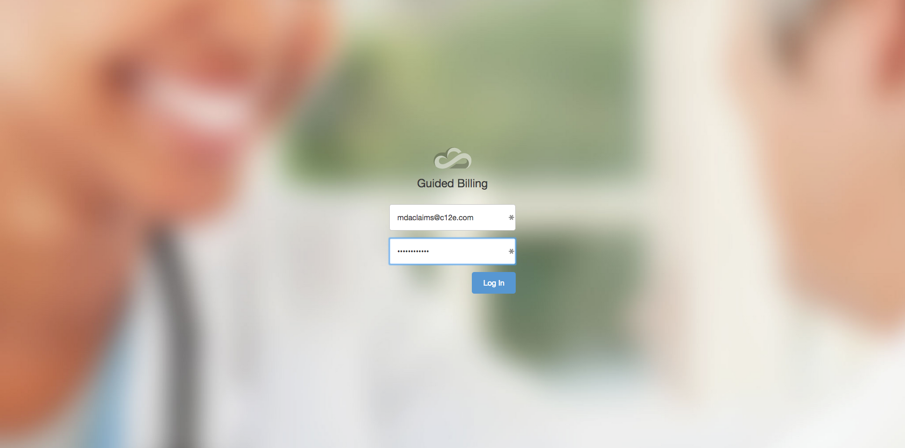

Slide 27
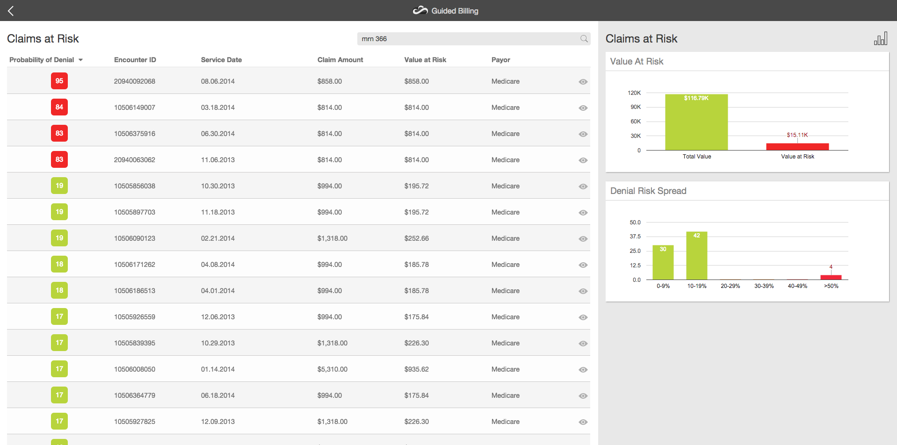

Slide 28
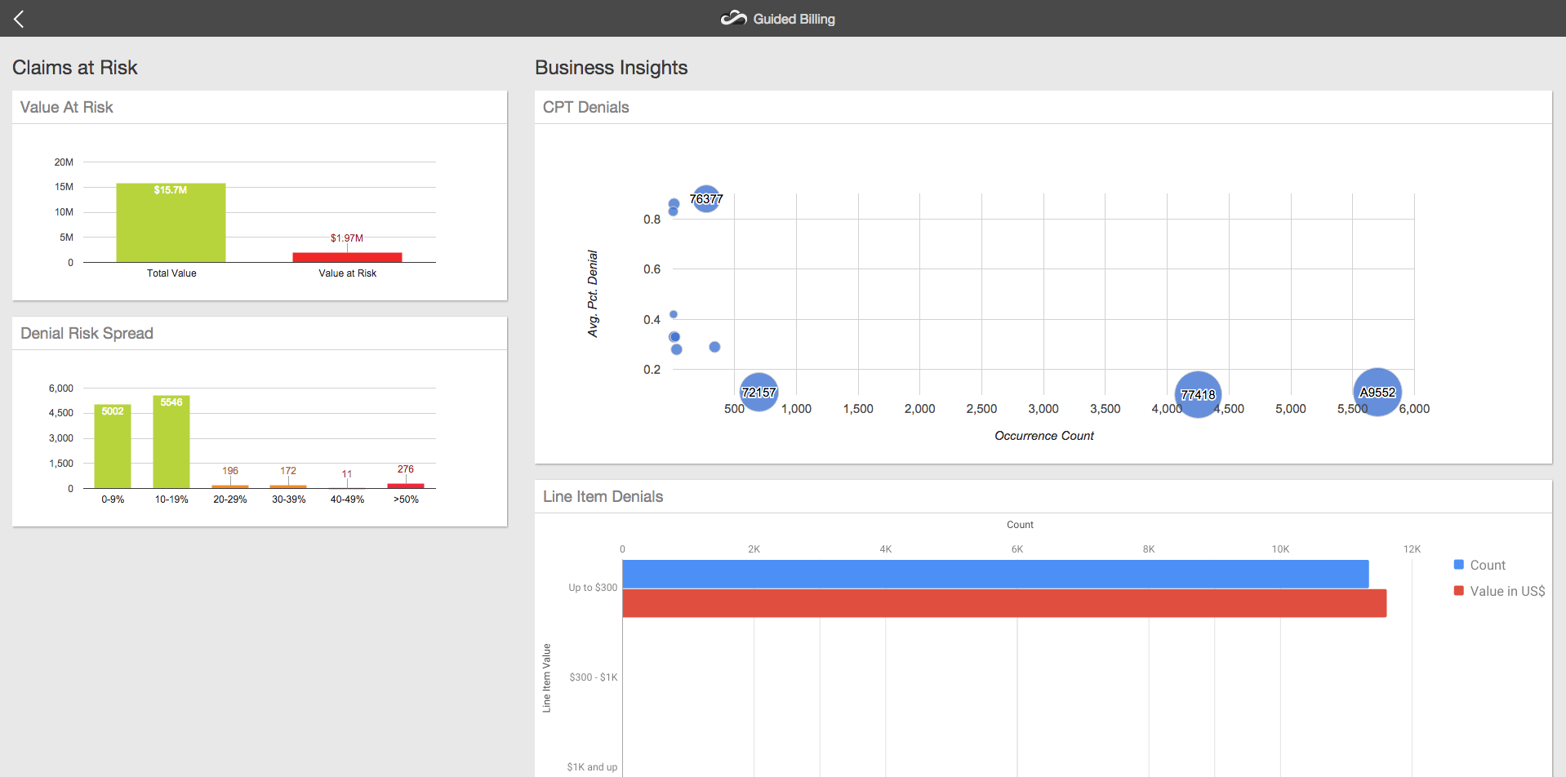

Slide 29
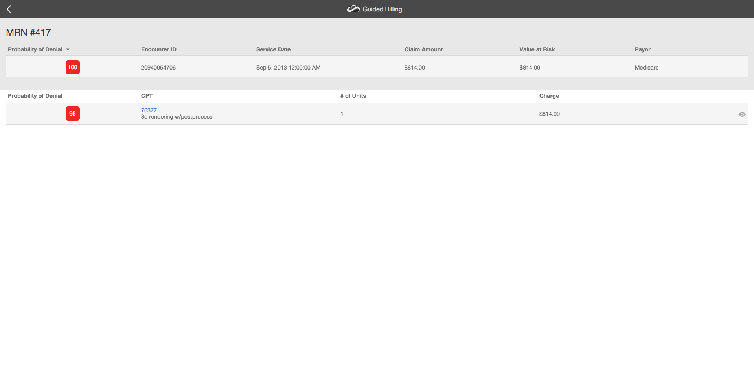

Slide 30
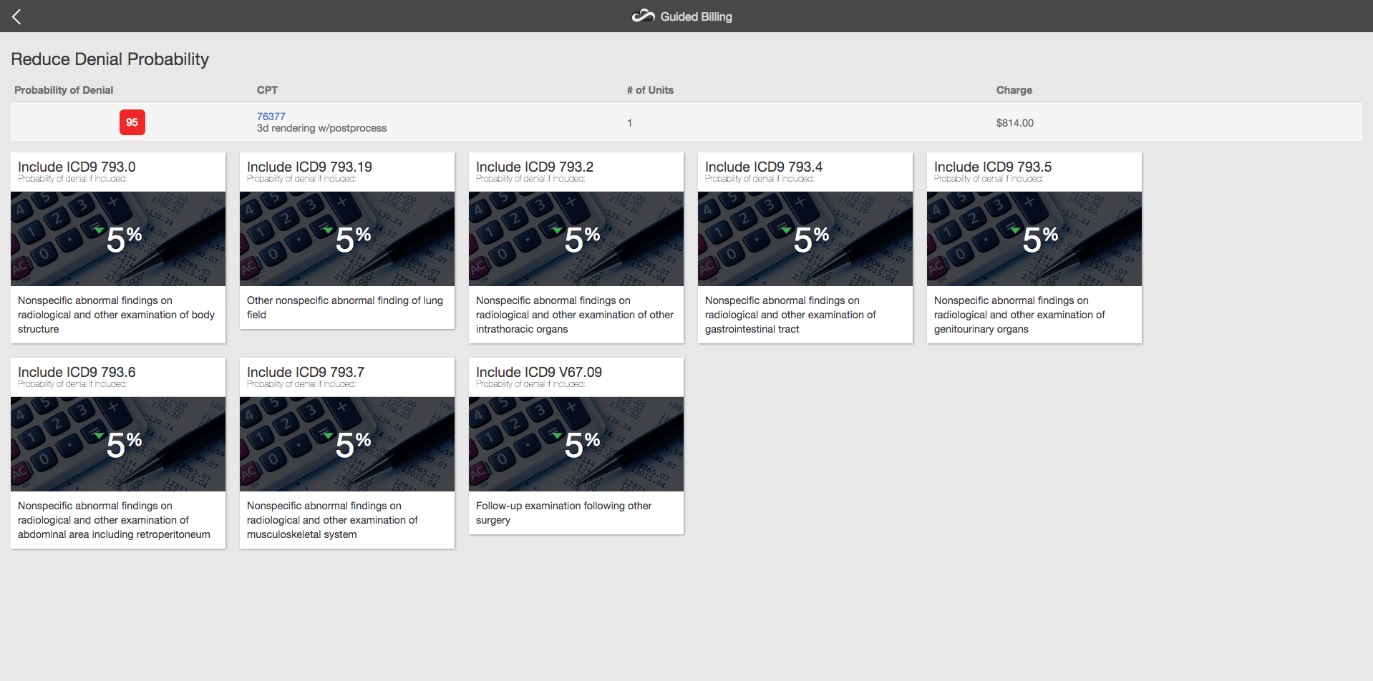

Slide 31
www.mdanderson.org • www.mdanderson.org/ask
1-877-MDA-6789

Slide 32
eHI Data Analytics Community
eHI is creating a LinkedIn group for the Data Workgroup participants.
This will provide an opportunity to connect, network, and learn with other eHI members
Details to connect will be provided

Slide 33
Workgroup Discussion
Review of Workgroup plan, deliverables for 2015 and timeline
Review survey questions
Timeline

Slide 34
Workgroup Deliverables
Develop a report/toolkit that explores the current best practices for sharing data with 3rd parties and build consensus around appropriate secondary data uses.
To include:
  access to data and the use of predictive analytics.
  access to data and the growing role of analytics in driving value-based healthcare
  examples that demonstrate the use of analytics in identifying patients at risk, aligning appropriate interventions, and improving health outcomes

Slide 35
Work Group Plan
Determine scope of practices to research
Identify sources for outreach
Determine information to be included in use case scenarios
Develop outreach communication to both eHI members and community
Define framework for categorizing and assessing best practices
Collect and assess best practices
Develop Use Case Selection Criteria
Develop report

Slide 36
Timeline
August
  Work Group Charge and Timeline
  Determine Scope of Practices to Research
  Identify Sources of Best Practices
  Develop a draft profile – information to be included in use case
September
  Review and Complete profile
  Develop communication for outreach
  Begin outreach
  Develop Framework for Assessing Best Practices

Slide 37
Timeline
October
  Continue Outreach
November
  Compile best practices
December
  Assess best practices
  Develop toolkit
January
  Prepare for eHI 2020 Conference February 2016

Slide 38
Questions for Survey
Contact Person
Type of organization
Executive Summary
Implementation
  What data sets did you use?
  What analysis was conducted?
  What questions were you trying to address?
  Who conducted the analysis?
  How was the analysis used/implemented? By whom? What processes were changed? Etc.
Quantitative Data
  Number of physicians involved
  Number of patients involved
  Timeframe
Challenges Encountered
What were the outcomes?
  Impact on quality, Satisfaction, reduction in costs, reduction is utilization of services (ED visits, hospitalizations)
  Policies adopted
  Key lessons learned
Research associated with implementation (if any)

Slide 39
Next Steps
Finalize survey questions and send out
  Comments – please email Claudia.Ellison@ehidc.org by September 8
Next Workgroup Meeting: October 9
  Develop Framework for Assessing Best Practices
  Continue outreach
  Compile best practices

Slide 40
Questions?

Slide 41
Thank you!

