Slide 1
eHealth Initiative Data Analytics
Sub-Workgroup
June 4, 2015
2:00 – 3:00 pm ET

Slide 2
Reminder
Please mute your line when not speaking
(*6 to mute; *7 to unmute)
This call is being recorded
Slides from today’s presentation are available at ehidc.org.

Slide 3
Agenda
2:00 – 2:05 Welcome & Introductions
2:05 – 2:45 Presentation with Q&A
2:45 – 3:00 Member update; Speaker
Recommendations

Slide 4
About eHealth Initiative
Since 2001, eHI is the only national, non partisan group that represents all the stakeholders in healthcare
Mission to promote use of information and technology in healthcare to improve quality, safety, and efficiency
eHealth Initiative focuses its research, education, and advocacy efforts in three areas:
  Business and Clinical Motivators
  Interoperability
  Data Access and Use

Slide 5
Data Analytics Sub-Workgroup
Purpose
Recognizing that the ability to collect meaningful exchange health data is valueless unless it is appropriately accessed and analyzed to inform clinical decisions about an individual’s condition and possible interventions is an important component in our efforts towards better health outcomes.
eHealth Initiative has created the Data and Analytics Sub Workgroup under the Data Access and Use Workgroup that will primarily focus on access to data and the use of predictive analytics. This group will focus on key issues including access to data, data analytics, and use cases to highlight the use of predictive analytics to identify patients at risk, align appropriate interventions, and improve health outcomes.
This group will meet on the first Thursday of every month from 2:00 pm – 3:00 pm EDT to focus on appropriately broadening access to data and the growing role of analytics in driving value-based healthcare.

Slide 6


Clinical Decision Support
Analytics in Action: Risks & Rewards
Presented to eHEALTH INITIATIVE
Sarah Churchill Llamas, JD
Chief Operating Officer
iMorpheus Informatics System
Sonic Healthcare USA
June 2015
sllamas@sonichealthcareusa.com
Notes:
[

Slide 7
Quality and Safety Problems in Healthcare
Patients only receive the recommended care 55% of the time (2003 Rand Study: The First National Report Card on Quality of Health Care in America)
2010 AHRQ found recommended care rec’d 75% of the time.
Medication errors
  50% of errors occur during the ordering stage
    Mostly dosing errors
  25% at administration stage
Still few penalties for unsafe care, but that is starting to change.

Slide 8

How Clinical Decision Support Can Help
Clinicians look at results, document orders, document notes, and communicate with others daily.
Clinical decision support: trying to embed clinical knowledge and recommendations within the workflow
Benefits:
  Realize best practices
  Adherence with guidelines
  Provide safer care
  Provide reliable care
  Realize cost savings

Slide 9
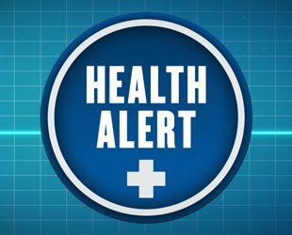
Uses of Clinical Decision Support
Workflow support
  Increases the standardization and reliability of care
    Order sets
    Medication reconciliation process during TOC
  New workflows emerging who need analytics support
Synchronous data entry checking, rules and alerts
    Drug-drug and drug allergy checking
    Alerts to make sure labs are ordered in conjunction with a medication
    Drug dosing decision support
    Health maintenance reminders
      Mammogram reminders
      Regular cholesterol checks
      Regular HbA1c orders
Analytics regarding cost and clinical appropriateness (population management or health benefits planning)

Slide 10

Advantages of Clinical Decision Support
Increased quality of care among geographically separated members of a single health care team;
Avoidance of medical errors;
Increased efficiency;
Improved drug compliance;
Utilization of proper preventive services;
Proactive outreach;
Chronic care management
Cost savings; and
Revenue capture.

Slide 11
Example: Order Sets
A collection of orders that can be entered at one time
  Could be diagnostically driven or task driven
Advantages
  Speed computerized order entry
  Represent best practices
  Decrease variations in care
  Care elevated to the level of experts
Challenges
  Needs to be developed
  Requires domain expertise from multiple places – nursing, pharmacy, laboratory, radiology, etc.
  Needs to be used to be effective
  Needs to be maintained
  Needs to limit personal order sets

Slide 12
Rule-Based Clinical Decision Support
Characteristics of individual patients are used to generate patient specific interventions, assessments, recommendations, or other forms of guidance that are then presented to a decision making recipient or recipients that can include clinicians, patients, and others involved in care delivery.
ONC believes it represents one of the most promising tools to mitigate the ever-increasing complexity of the day-to-day care practice of medicine. When implemented successfully, CDS can assure that all patients in a practice receive appropriate and timely preventive services.
The effective use of a clinical decision support system means patients get the right tests, the right medications, and the right treatment, particularly for chronic conditions.

Slide 13
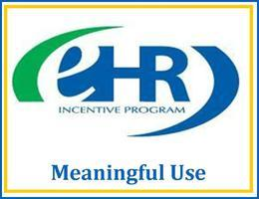
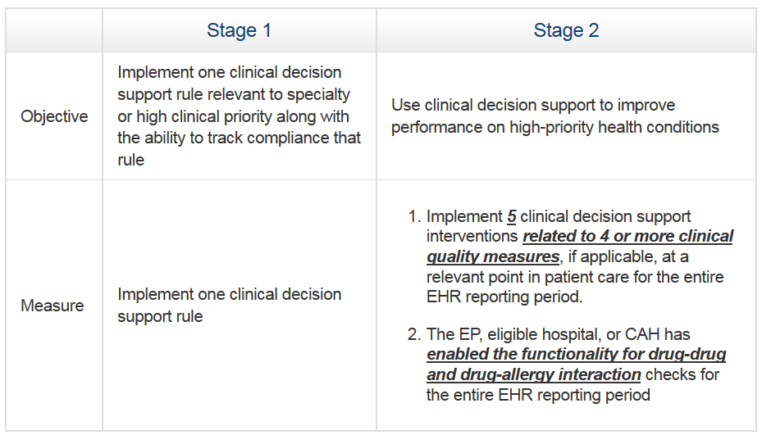
Meaningful Use and Clinical Decision Support

Slide 14

FDA Regulation
FDA plans to release a separate guidance on CDS software (apart from the recent Mobile Medical Applications guidance).
FDA has authority to regulate HIT but has not done so except in limited ways — authority limited to HIT that meets the definition of a “medical device.”
When even serious safety-related issues with software occur, no central place to report them to, and they do not generally get aggregated at a national level.

Slide 15
Evidence of Risk
Some health information technology (HIT) vendors have voluntarily registered their products as devices and reported adverse events.
  The FDA has received 260 reports of HIT-related malfunctions with the potential for patient harm (including 44 injuries and 6 deaths).
The reported adverse events fall into four categories:
  Errors of commission, such as accessing the incorrect record or overwriting information;
  errors of omission or transmission in which patient data may be lost;
  errors in data analysis, including medication dosing errors; and
  incompatibility between systems
ONC has found that alert fatigue creates a nuisance leading to under-reliance on systems.

Slide 16

One Risk: Alert Fatigue
Must strike a balance: alert fatigue vs. decrease in errors
  Physicians may become rapidly
  desensitized to overly abundant
  warnings
Increases physician liability risk, since automated warnings will be less helpful in reducing errors, even while the system creates an audit trail for ignored CDS warnings.
Vendors are worried about missing needed alerts so they are creating CDS systems that generate massively over-inclusive automated warnings.

Slide 17
Current Legislation
Sensible Oversight for Technology Which Advances Regulatory Efficiency Act of 2013 (‘SOFTWARE Act’)
  The bill creates three categories of software: clinical software, health software, and medical software. Under this proposed regime, neither clinical nor health software would be subject to regulation.
Preventing Regulatory Overreach to Enhance Care Technology (‘PROTECT Act’) introduced Feb 2014 in Senate
  Completely removes some high-risk CDS software (including software used to make complex medical decisions) from the FDA’s regulatory jurisdiction

Slide 18
McKesson Technologies – Lessons from an FDA Recall
FDA recently issued a Class I recall of McKesson’s Anesthesia Care Software
Collects, processes, and records data both through manual entry and from monitors which are attached to patients, such as in an operating room environment. The system provides clinical decision support by communicating potential adverse drug event alerts proactively during the pre-anesthesia evaluation and at the point-of-care.
Patient data was not accurate upon recall – it included other patient’s information.
(McKesson is a public supporter of reference legislation.)

Slide 19
McKesson Technologies – Lessons from an FDA Recall
A mere database lookup engenders risk, if the user is dependent on it.
FDA also seems to be saying that even clinical decision-support software aimed at supporting the most educated of healthcare professionals can be high risk if that dependency exists.
FDA is highly concerned about failures that are not obvious to the user, where the user would not have reason to become suspicious or investigate further. A software error that simply replaces one person’s data with another may not be obvious to the user, and in this case could lead the doctor to provide the wrong treatment at a very critical juncture.

Slide 20

Liability Issues
Does the use of CDS involve any incremental malpractice risk for the physicians who opt to use the technology?
Should the federal government take a greater role in regulating CDS software as a medical device?
Should Congress create a safe harbor to insulate providers from tort liability for relying upon CDS software?

Slide 21
What Are The Legal Risks?
Negligence - Malpractice liability is premised on a professional standard of care, as defined by the experience and training of a hypothetical “prudent physician” and by the actions that physician would take if confronted by a particular clinical situation and set of circumstances.
If particular clinical practices, including those involving the use of health information technology, became widely accepted as a benchmark of quality care, then those practices might also be integrated into the legal malpractice standard.

Slide 22
Resulting Negligence
Result: physicians who do not have the time or skill to assimilate the unprecedented amount of available data and to optimize their use of technology, may face medical malpractice claims that would never have emerged in the past.
BUT physicians are using the medical software as a diagnostic and treatment aid, not as a substitute for their own medical judgment.
Courts would likely find a physician liable for harm that resulted from the use of CDS–even if there were a mistake in the medical knowledge database–if the physician failed to question bad advice given by the CDS software and provided improper care to the patient that caused harm.

Slide 23
Liability for Hospitals and Healthcare Organizations
Hospitals are not directly liable for the negligence of non-employee physicians, but the hospital may face lawsuits for corporate negligence.
For a plaintiff to prevail on a theory of corporate negligence, the plaintiff would have to show, in part, that the hospital had actual or constructive knowledge of the flaws or procedures that caused the injury.
Minimize risk
  Proactively develop the ability to detect clinical software problems
  Ensure that clinicians receive thorough and adequate training
  When purchasing, evaluate the extent qualified end users can recognize and easily override erroneous recommendations

Slide 24
Vendor Liability
“Learned Intermediary” Doctrine – Allows manufacturers to discharge their duty of care to patients by providing reasonable instructions or warnings to the prescribing physicians.
To this point, no court has applied product liability standards to computer software.
Most medical software vendors disclaim warranties in their contracts and insist on “hold harmless” (indemnification) clauses that protect the vendor from liability even when HIT users are strictly following vendor instructions.

Slide 25
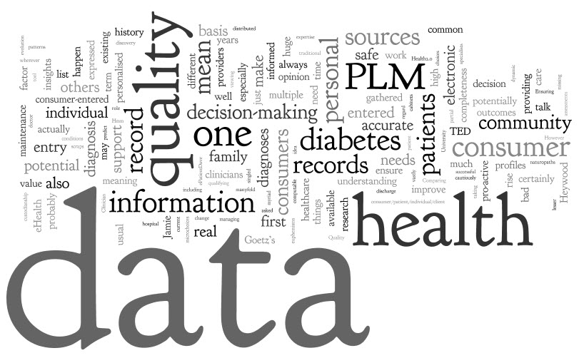

Availability of Data
CDS systems need ‘good’ data to act upon.
Becomes difficult in a heterogeneous system (disparate sources)
  Need for MPI and HIE technologies emerge

Slide 26
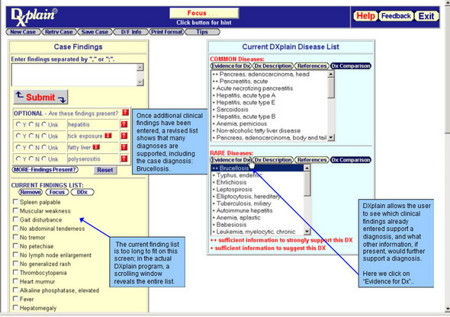
User Interface Issues
What functionalities should a screen have when it’s telling a physician not to do something? Are they getting all the information they need to make the right decision? Are they offered acceptable alternatives? How does it change their workflow?
Usually, the CDS component may be delivered by a different vendor than the EHR application that’s trying to deliver the results of the clinical decision support.

Slide 27
Analytics on Laboratory Data

Slide 28
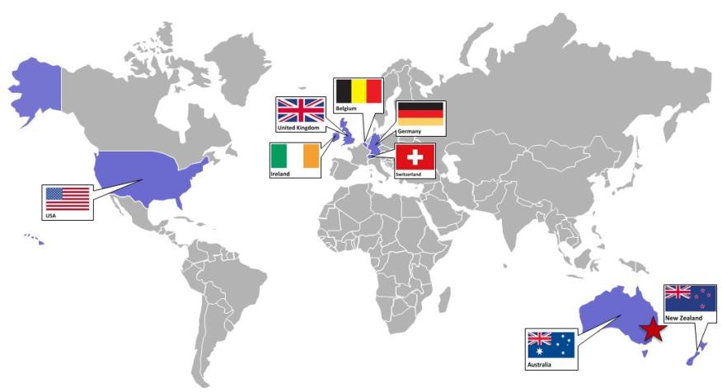
Sonic Healthcare Worldwide
Eight countries on three continents; $7B market cap (ASX:SHL)
Notes:
On 3 continents in 8 countries - with advanced medical infrastructure
Largest commercial lab in Australia and Europe
Delivering healthcare locally - with access to global resources
ABILITY TO MAKE SIGNIFICANT INVESTMENTS TO SUPPORT EXPANDED BAPTIST ROLE

Slide 29
Sonic Healthcare
Sonic Healthcare is one of the world's largest medical diagnostics companies, providing laboratory and radiology services to medical practitioners, hospitals, community health services, and their collective patients. We also operate Australia's largest network of primary care medical centres - Independent Practitioner Network (IPN) - as well as other healthcare businesses.
Sonic Healthcare was listed on the Australian Securities Exchange (ASX) in 1987 and, following a reconstitution of the Board in 1993, has experienced exceptional growth. Since 1993, our annual revenues have risen from A$25 million to over A$3.9 billion, making us a top 50 company on the ASX.

Slide 30
Sonic Healthcare USA
ESCL, Providence, RI
Sunrise, Hicksville, NY
PLI, Toledo, OH
CBLPath, Rye Brook, NY
FML, Chantilly, VA
CCPL, San Luis Obispo, CA
PML, Winchester, VA
PAL, Bakersfield, CA
AEL, Memphis, TN
Mullins Lab, Augusta, GA
SHUSA HQ and CPL, Austin, TX
CHI, Orlando, FL
CLH, Ewa Beach, HI
2005
2006
2007
2008
2009
2010
2013
Notes:
30
Entered the U.S. eight years ago
Third largest commercial lab system in the U.S within 6 years.
Covering two-thirds of the population of the U.S.
Advanced clinical and anatomic pathology capabilities
About 15 laboratories in eight regions across the U.S.
Local autonomy – with access to worldwide Sonic capabilities:
Resources
Purchasing
Technology
Experience

Slide 31

Lab Testing is a Key Regulator of Other Healthcare Costs
Healthcare Costs
Lab Testing
Notes:
Turbulent times ahead - it is also an opportunity for the lab to shine!
Key message – important message
Lab testing is a highly leveraged activity in preventative & downstream cost control
Lab services can play a major role in an outcomes based HC environment.

Slide 32
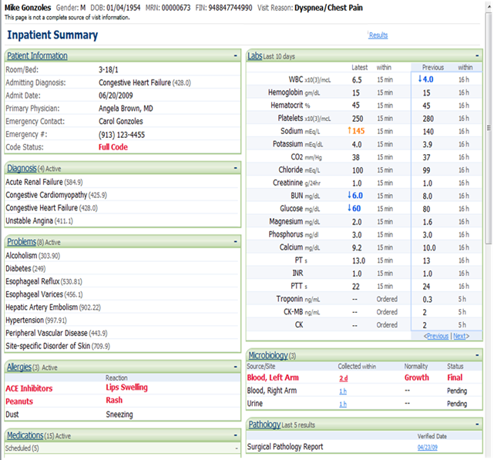
Testing a small % of costs - large impact on non-lab downstream costs
3%-4% - percentage of lab costs on typical health system or hospital operational budget
50% - 70% – typical content of lab and testing results in the average patient’s chart
70% - 80% – percentage of non-lab downstream health care costs influenced by lab testing
Cerner EMR
Source: G2 Lab Institute 2013 Meeting, Washington, DC
Notes:
Lab costs is inclusive of space, personnel instruments and equipment spent by the hospital to operate its own laboratory(ies) w/in the health system or hospital
50%-70% quoted as the portion of a typical inpatient EMR that are lab and biometric data (lab results/vitals)
70%-80% are the percentage of downstream costs directly influenced by lab data

Slide 33
The Case for Clinical Decision Support in Lab Testing
3,500 tests riddled with confusing nomenclature
Participants reported ordering diagnostic testing in 31% of patient encounters per week, with uncertainty about ordering and interpreting tests 14.7% and 8.3% of the time, respectively
300 million PCP visits in the U.S. = 23 million patients per year potentially experience inappropriately ordered or interpreted tests
Study found a gap between how helpful PCPs found lab consults and how infrequently they reported using them
Survey respondents thought information technology (IT) and systems-type solutions like reflex testing, trending, interpretive comments, and computerized physician order entry with electronic suggestions were most likely to help them.
J Am Board Fam Med 2014;27:268–74: Primary care physicians' challenges in ordering clinical laboratory tests and interpreting results.

Slide 34
How Sonic is leveraging laboratory data
While laboratory testing is about 2% of healthcare costs, it offers many potential intervention points in the care delivery cycle. Utilizing laboratory data appropriately can reduce expensive "downstream" healthcare costs.
Sonic “Expert System” has a proven ability to assist health systems in population health management, chronic care management, and disease prevention. It is a proprietary interactive database useful in accountable care and in-patient environments.

Slide 35
Examples of how lab data can be utilized
Identifying care gaps
Performance tracking
Utilization review
Quality measures
Appropriate follow up

Slide 36
Example: Population-based study utilizing lab data
In the states that expanded Medicaid, the number of Medicaid enrollees with newly identified diabetes rose by 23 percent.
The diagnoses rose by only 0.4 percent — to 11,653 from 11,612 — in the states that did not expand Medicaid.
In all, the study identified almost 500,000 people as having diabetes — equal to about a quarter of all new American cases in a year.
Note: This study was not done by Sonic and Sonic does not endorse its accuracy.

Slide 37
Clinical Decision Support
Analytics in Action: Risks & Rewards
Presented to eHEALTH INITIATIVE
Sarah Churchill Llamas, JD
Chief Operating Officer
iMorpheus Informatics System
Sonic Healthcare USA
June 2015
sllamas@sonichealthcareusa.com
Notes:
[

Slide 38
Any discussion questions

Slide 39
Workgroup Discussion
Member Updates
Discussion of workgroup content and speaker recommendations

Slide 40
Meeting Conclusion

