Slide 1
eHealth Initiative Business and Clinical Motivator Work Group
September 9, 2015
2:00 p.m. EDT

Slide 2
Reminder
Please mute your line when not speaking
(* 6 to mute, *7 to unmute)
This call is being recorded

Slide 3
Advisory Council
Thomas Kuhn
Sr. System Architect, ACP
Len Lichtenfeld
Deputy Chief Medical Officer, American Cancer Society
Michael Morgan
CEO, Updox
Robert Porr
EVP Sales & Marketing, Sandlot Solutions
Tony Schueth
CEO and Managing Partner, Point-of-Care Partners

Slide 4
Agenda
Welcome and Overview of Agenda
Leslie Kelly Hall - Chair
Senior Vice President, Policy, Healthwise
Introduction of Speaker & Presentation
Workgroup goals, process and timeline
We need your input!
Next Steps

Slide 5
eHI Business and Clinical Motivators Workgroup
Madeleine Konig, MPH
Senior Policy Analyst
Madeleine.Konig@heart.org

Slide 6
Presentation Topics
Review American Heart Association/American Stroke Association tools designed to support improved quality of care and care coordination
Look at tools focused on both provider and patient audiences
Topics:
Get With the Guidelines (GWTG)
The Guideline Advantage (TGA)
Heart 360
Patient Support Network

Slide 7
AHA – Mission and Approach
Cardiovascular (CV) disease is our nation’s #1 killer
Over 81 million Americans currently suffer from CV disease
1 out of every 3 people in the U.S.
Mission – Build Healthier Lives, Free of Cardiovascular Diseases and Stroke
2020 Impact Goal – Reduce CVD and stoke mortality and morbidity by 20% for all Americans by 2020

Slide 8
AHA/ASA Background
Move beyond acute treatment and focus on prevention
Provide knowledge-based solutions for people of all ages, relative to their risk
Strategies
Patient/Consumer centered health – Be where people are with the right message the right tools, at the right time
Empowerment is key to driving adherence
Providers – Assist providers in delivering evidence-based care
Guideline translation

Slide 10
What is Get With The Guidelines?
It’s not a registry, it’s Continuous Quality Improvement
The integration and translation of:
Evidence-based medicine
Technological based, decision support, data collection and feedback introduced at the point of care
A cultural system CHANGE within hospitals, market, state, & country to operate in an integrated seamless manner
Mechanisms to continuously improve and measure quality
In essence, a paradigm shift for health care delivery
10
Notes:
10

Slide 11
Designate A Champion
and Build Your Team
The Five GWTG Implementation Steps
Assess Adherence Rates
Analyze current
adherence rates
Implement Refined Protocol/Process
GWTG team Implements “fixed” Protocols/Process to all applicable areas
Refine Process/Protocols
GWTG team reviews PMT reports and hypothesize the “fix”
Measure Protocol/Process
GWTG team tests and measures the adherence rates
for the refined Process/Protocols

Slide 12
The Patient Management Tool
The Get With The Guidelines Patient Management Tool® (PMT) provides applications as easy-to-use web-based tools.
Online, interactive assessment and reporting systems that aid in Get With The Guidelines program implementation.
Provide patient-specific ACC/AHA guideline information and enable each institution to track its adherence to the guidelines individually and against the AHA’s national benchmarks over time.
PMT helps hospital care teams manage each patient to the guidelines and reduces missed cases.
Demonstrated effectiveness in improving hospital compliance rates with guidelines.
Technical support from the Outcome help desk and one-on-one support from the American Heart Association field staff.

Slide 13
Recognition from the American Heart Association
Get With The Guidelines®
Achievement Awards
85% compliance for module specific Achievement Measures
Bronze: 90 consecutive days
Silver: 12 consecutive months
Gold: 24 consecutive months
Get With The Guidelines®
Plus Awards
Must have current Silver or Gold Award for Get With The Guidelines®
Hospital may self select group of Quality Measures and demonstrate 75% compliance for same time period as Silver or Gold Award
Our goal is help hospitals improve care processes to therefore help us reach our Mission of Building Healthier Lives Free of Cardiovascular Disease and Stroke.
Because our hospitals join us in this mission and see measurable results, we want to congratulate them for a job well done.
Hospitals that meet eligibility criteria may apply for the Get With The Guidelines® Performance Achievement Awards and will be recognized in USNWR advertisement, Circulation advertisement and the International Stroke Conference and Scientific Sessions

Slide 14
Get With The Guidelines® Heart Failure Hospitals Have Demonstrated Equitable Care
Thomas KL, Hernandez AF, Dai D, Heidenreich P, Fonarow GC, Peterson ED, Yancy CW Association of race/ethnicity with clinical risk factors, quality of care, and acute outcomes in patients hospitalized with heart failure.
Amer Heart J 2011, April 161 (4) 746-54.
U.S. hospitals participating in the American Heart Association’s Get With The Guidelines®–Heart Failure quality improvement program provided improved and equitable care for black, Hispanic and white heart failure patients.
Hispanics and blacks hospitalized with heart failure have more cardiovascular risk factors, such as diabetes and high blood pressure, and tend to be younger than whites hospitalized with heart failure.
However, at Get With The Guidelines–Heart Failure hospitals, Hispanics and blacks were less likely to die in the hospital than white heart failure patients.

Slide 15
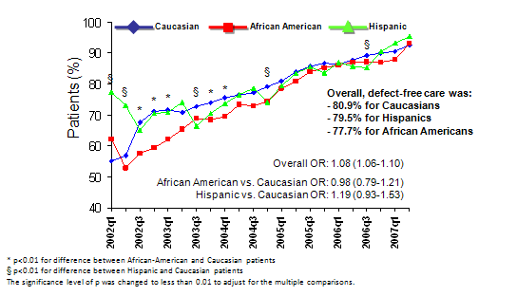
Defect-Free Care
Cohen et al. Circulation . ePub May 17, 2010

Slide 17
The Tri-Agency Relationship
Program Advantages
A joint program of the American Cancer Society, the American Diabetes Association, and the American Heart Association
Each organization has long developed scientific statements and guidelines specific to prevention and disease management
Shared goals:
Sets national goals and objectives that compliment their guidelines
Common interest in translating those guidelines into practice
Multiple participation models
Expanded
feedback
for quality
improvement
Online improvement tools
What is The Guideline Advantage?
Reaching a
broad range
of patients
Research and
Recognition
opportunities
Working with existing technology
17

Slide 18
Organizations came together in 2004 to:
Harness the individual strengths of each to collectively engage the issue of prevention
Create consistent prevention and screening guidelines
Reach widest constituency to increase awareness and inspire action
Further collective goals through joint initiatives
Notes:
18

Slide 19
Vision & Goal
To improve the health of all patients through widespread application of primary and secondary prevention guidelines in the United States through data collection, analysis, feedback and quality improvement in the ambulatory setting.
Vision
To improve the long-term compliance with the ACS, ADA and AHA/ACC guidelines, which in turn supports our shared organizational mission to prevent chronic diseases and to improve the lives of those living with the nation’s most prevalent chronic diseases.
Goal
The Guideline Advantage is based on the success of nearly 10 years experience in inpatient quality improvement and over 2 millions lives touched.

Slide 20
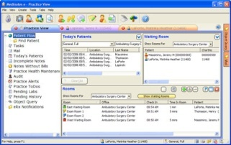
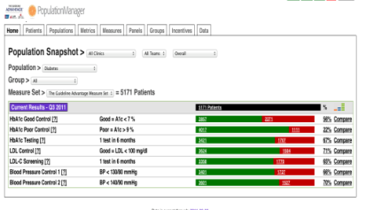
Program Model
Practices submit collective clinical data to Forward Health Group for The Guideline Advantage
2
Providers can use several different technology platforms
Data are processed, analyzed and provided back to the practice via a practice portal
1
3
4
Performance is measured, Professionals can set measureable goals and chart improvements in performance

Slide 21
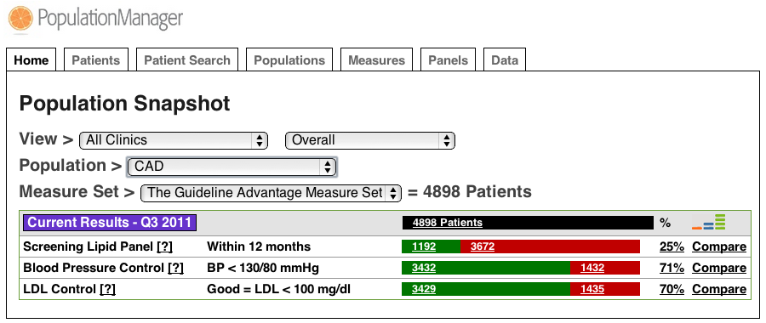
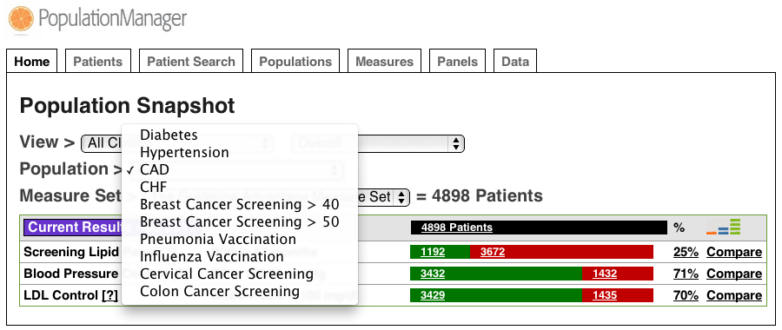
Program Platform
One-click access to patient lists
Measure Performance
Populations

Slide 22
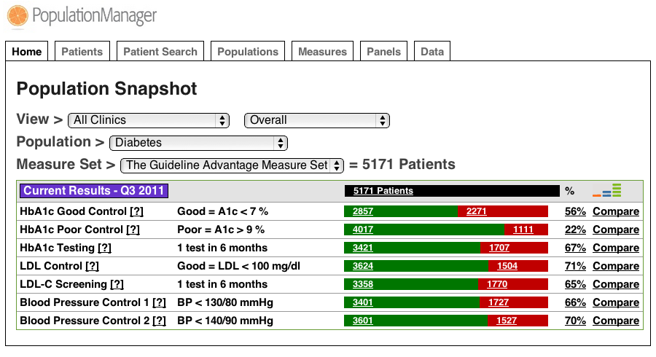
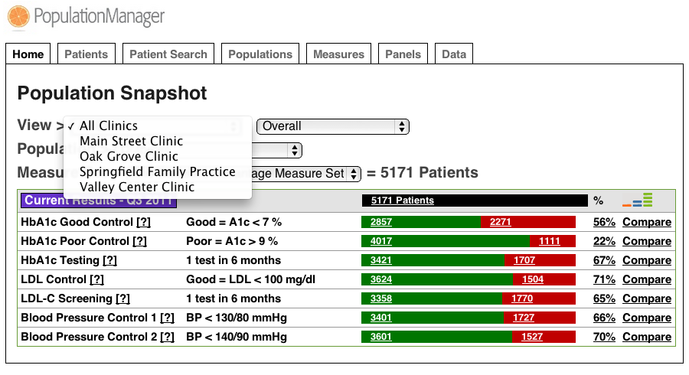
Available Data aggregation
System Level
Clinic View Options

Slide 23
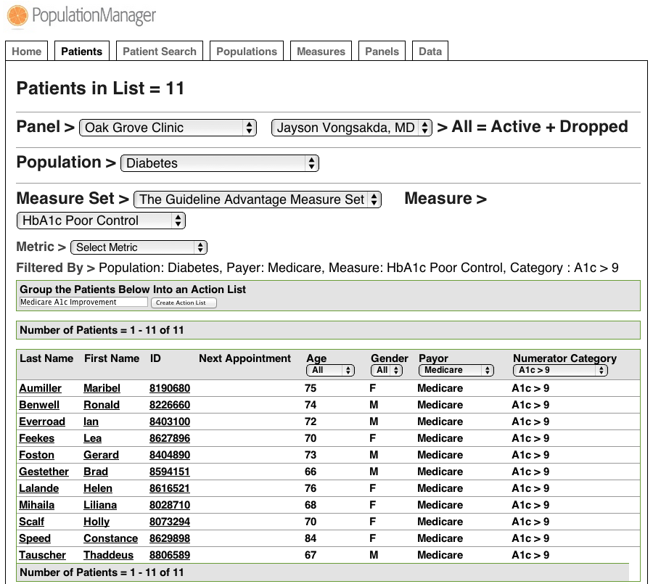
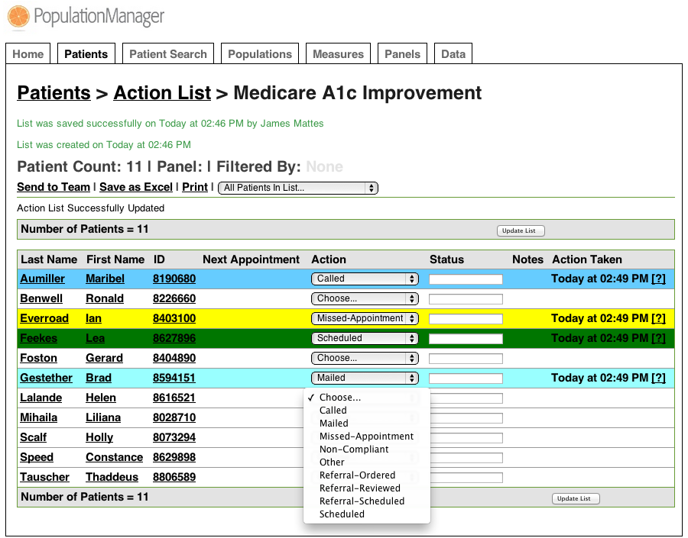
Action Lists
Filters to create action lists
Action items

Slide 24
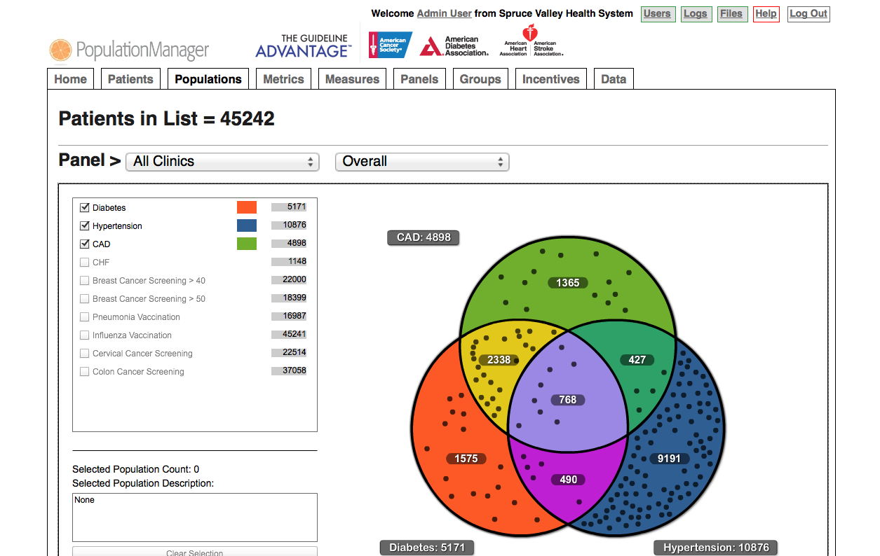
Co-Morbidity Venn Diagram

Slide 25
TGA’s Measures
Diabetes Mellitus
HbA1c Control
Preventive Care Screening
BMI Screening & Follow-up
Influenza Vaccination
Tobacco Use and Counseling
Cancer
Cardiovascular
Colorectal Cancer Screening
Mammography Screening
Cervical Cancer Screening
Ischemic Vascular Disease: Aspirin Use & Lipid panel
LDL Control
High Blood Pressure Control
Hypertension: Blood Pressure Control
CAD: Antiplatelet Therapy
CAD: Blood Pressure Control
CAD: Tobacco Use
Blood Pressure Screening
LDL Measurement
CAD: Lipid-lowering Therapy
Annual nephropathy screening (urine albumin)
*Measures are subject to change

Slide 26
Program Alignment
Million Hearts Initiative
The Guideline Advantage reports on the “ABCS” measures of interest to Million Hearts
Uniform Data System (UDS)
The program reports all adult UDS measures of interest to Community Health Centers and Federally Qualified Health Centers
Bridges to Excellence
The program can help systems participate in Bridges to Excellence, in markets where it is applicable, with no additional work required

Slide 27
Leading practices for effective participation
Best Practices
Use existing EHR platform; don’t interrupt work flow to collect data; offer vendor neutral program model
Provide tools and resources (Webinars, CME programs, etc.) to help develop a culture of quality improvement
Provide feedback and consult with practices on how to disseminate information
Encourage focus on 1-2 areas only
Direct practices to resources to support improvement
Recognize and link to incentives
These are just a few of the best practices shared by the program.
Notes:
27

Slide 28
AHA – Mission and Approach
Patient/Consumer centered health – Be where people are with the right message the right tools, at the right time
Empowerment is key to driving adherence

Slide 29
Consumer Web Page

Slide 30
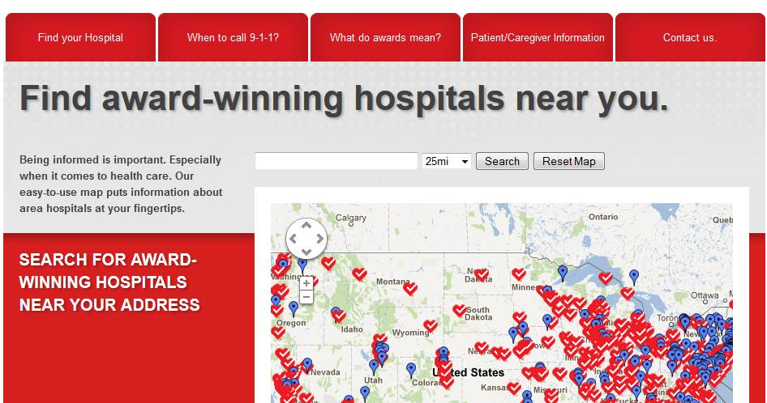
www.heart.org/myhealthcare

Slide 31
Heart360
31

Slide 32
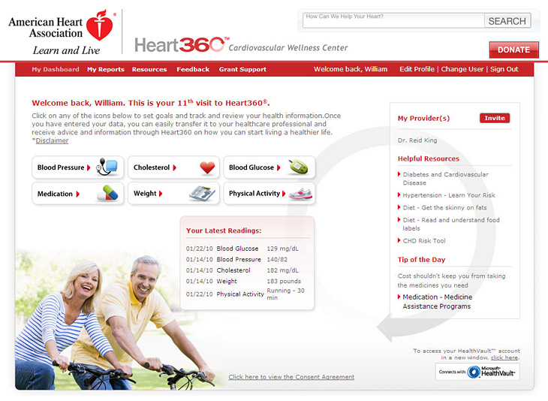
Patient Portal – Welcome Page
Dashboard summary
Easy site navigation
Physician access
Health resources
32

Slide 33
Set goals and track progress
Blood Pressure
Blood Glucose
Cholesterol
Weight
Medication
Physical Activity
33

Slide 34
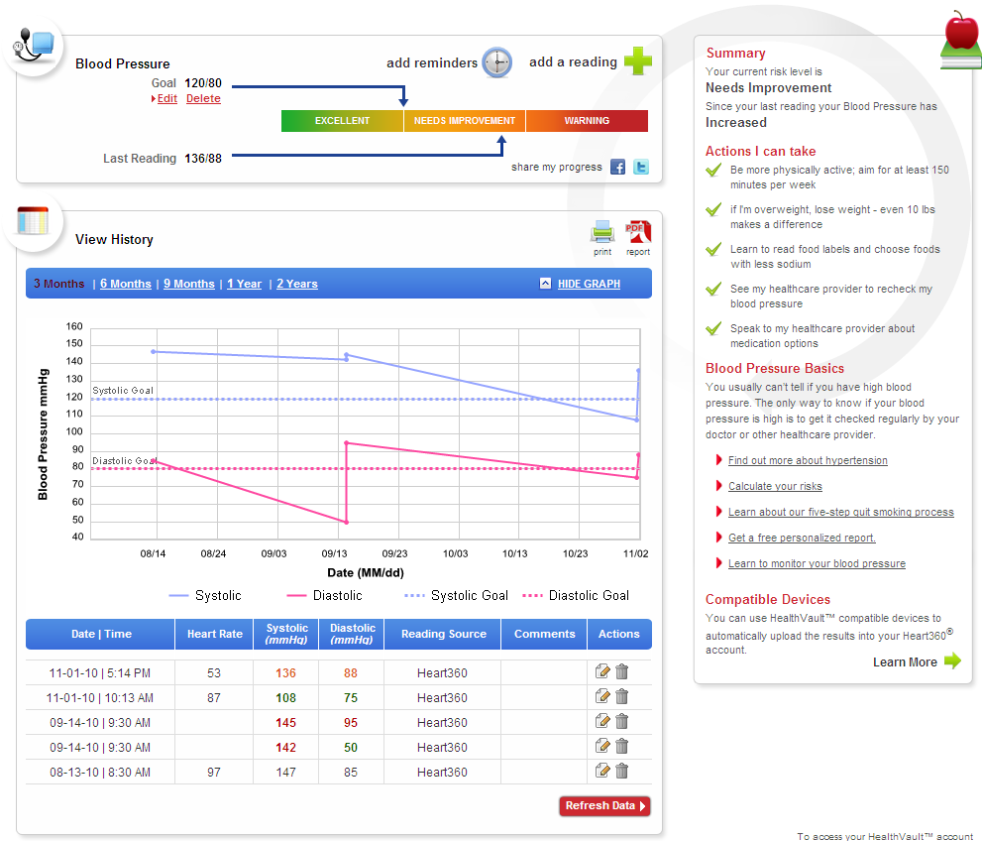
Patient Portal – Health Trackers
Review Goals and Progress
Monitor and track over time
Automatically upload from connected devices
34

Slide 35
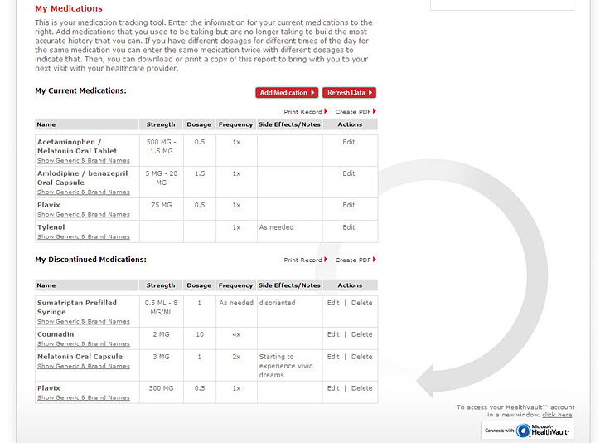
Patient Portal – Medication Tracker
Database of generic and brand medications
Track current and discontinued
HealthVault pharmacy partners
35

Slide 36
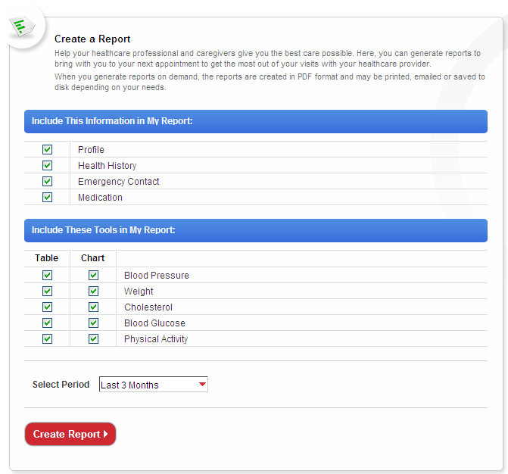
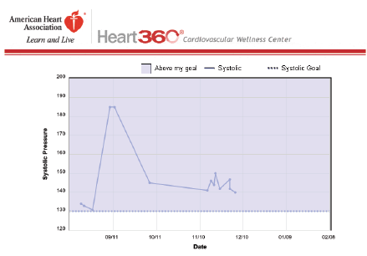
Patient Portal – Reports
PDF format allows for email or hard copy
Share with caregiver, physician, pharmacist
36

Slide 37
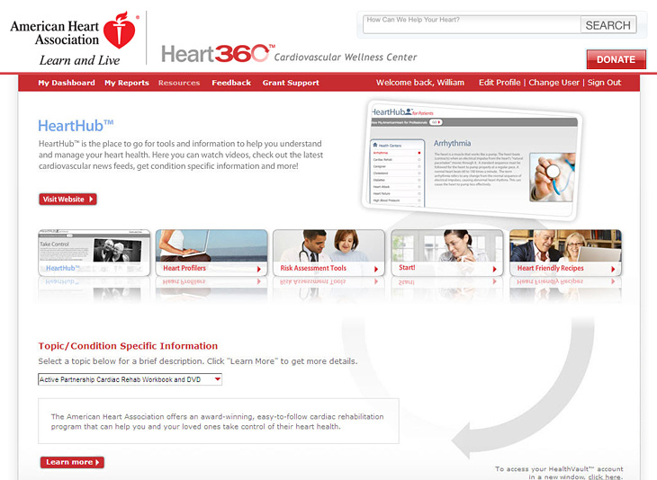
Patient Portal – Resources
Articles, tips, and guidelines
Interactive tools
Videos, podcasts, and animations
37

Slide 38
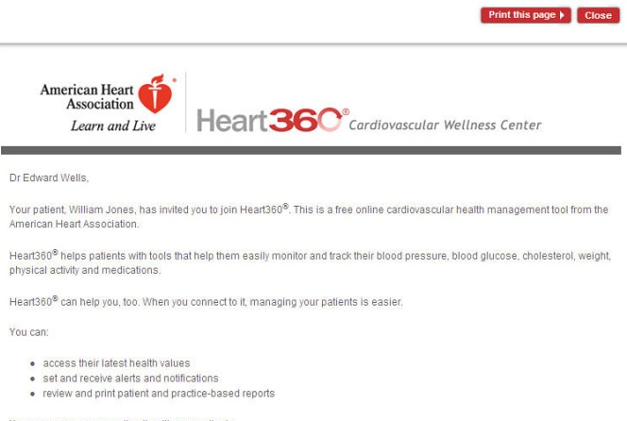
Provider Portal – Getting Connected
Option to email or print invitations
Physicians or patients initiate invitation
Invitation acceptance Provider code used for authentication
38

Slide 39
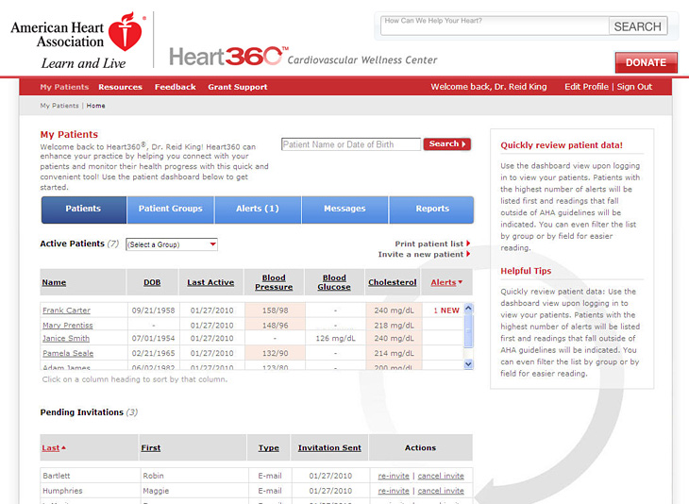
Provider Portal – Patient Dashboard
Dashboard view
Patient overview list
Filters and sorting
Management tools
Invite patients
39

Slide 40
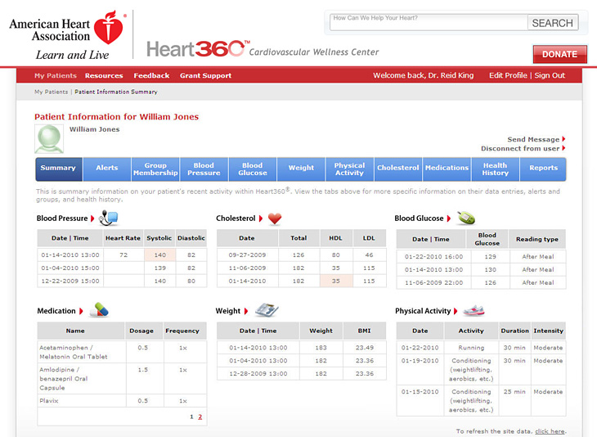
Provider Portal – Patient Management
Quick access to patient data
Easy access to patient specific management tools
40

Slide 41
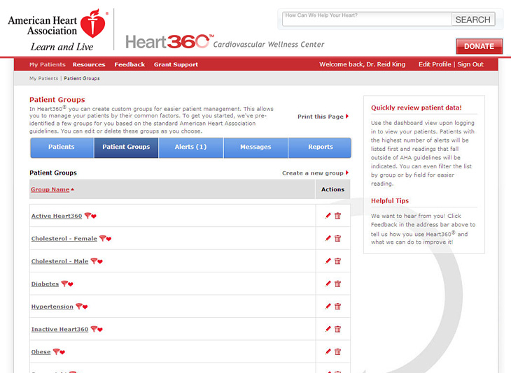
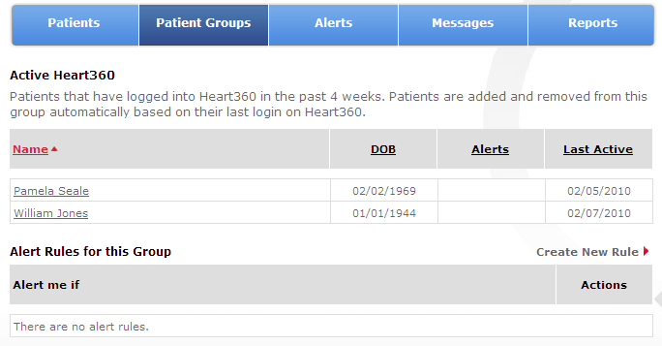
Provider Portal - Groups
Group types
Logic Driven Groups (i.e. Hypertension, Diabetes, Inactive)
Personalized Groups
41

Slide 42
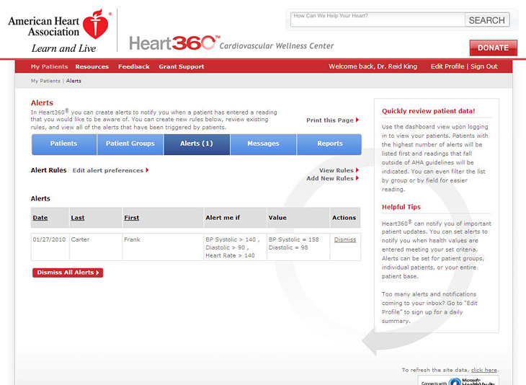
Set rules
Easily identify patients in need
Automatic patient-provider notification
Alert Me if Value is… Action?
42

Slide 43
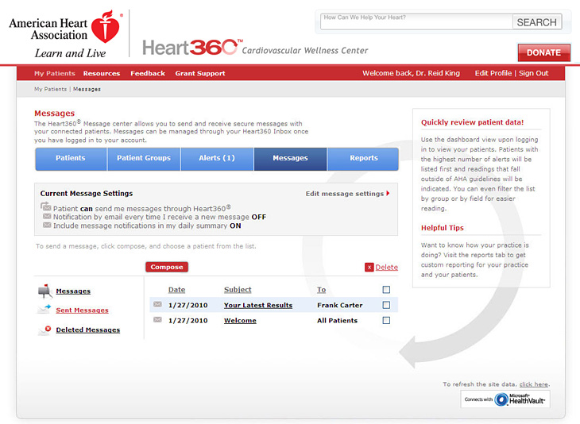
Provider Portal – Messaging
Communication ready
Message to individual, group, or all
Option to disallow patient connection
43

Slide 44
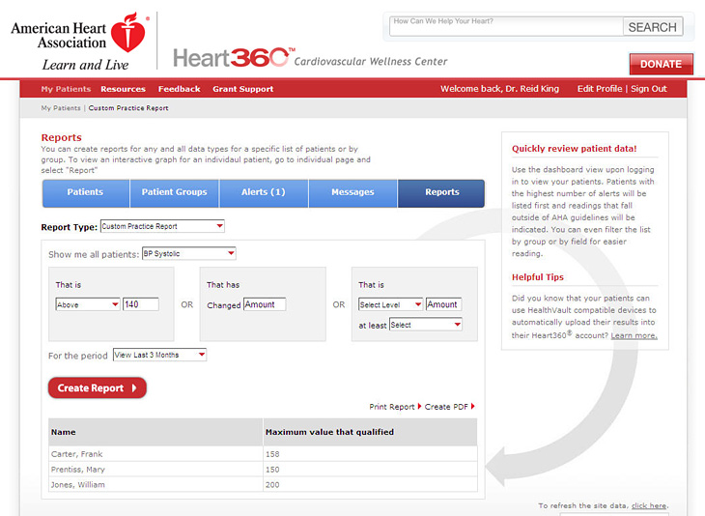
Professional View – Standard & Custom Reports
Individual patient reports
Standard practice reports
Custom practice reports
44

Slide 45
Facilitates emotional connections to deepen engagement between AHA/ASA and patients, caregivers and volunteers
Creates meaningful volunteer roles virtually and in their own cities and neighborhoods
Drives incremental revenue (donations, event dollars, major gifts, sponsorships, path to community walk teams, planned giving)
Improves knowledge, healthy behaviors and quality of life
The Support Network establishes AHA/ASA as a trusted source for patients, families and caregivers.

Slide 46
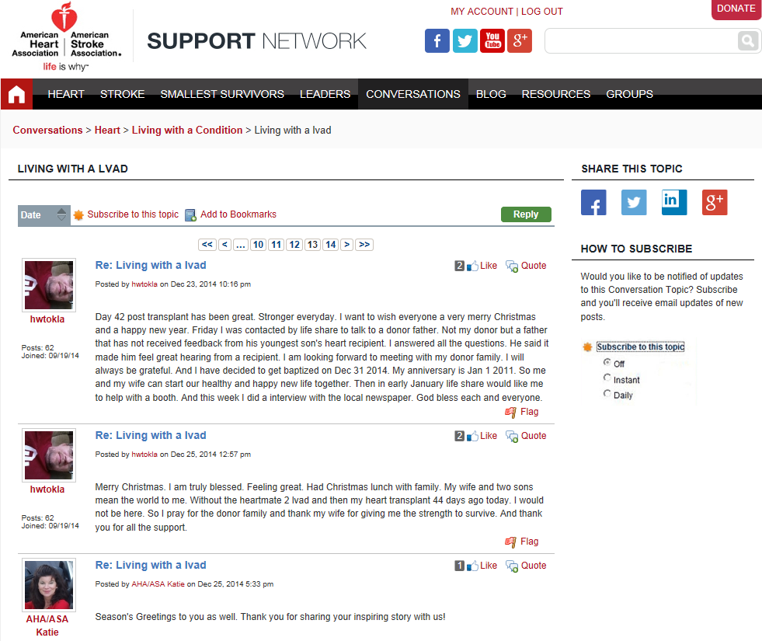
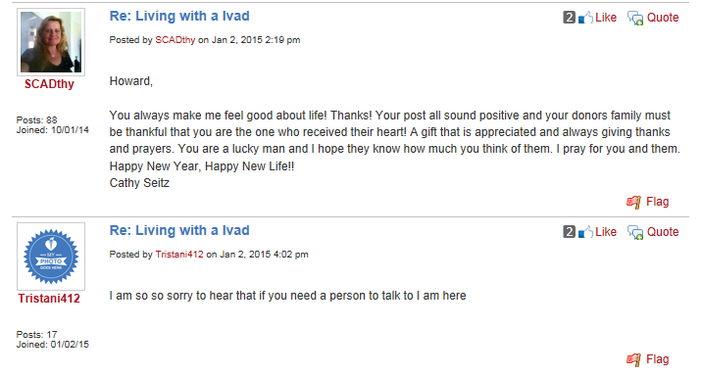

Slide 48
B&C Charter
Substantial investments have been made into health IT with the intent to create a more efficient and integrated healthcare delivery system. Those improvements hoped for include clinical outcomes and business outcomes that lowers costs across the healthcare ecosystem. To date, these outcomes have focused largely on physician workflow and system interoperability. Unfortunately, results have not met expectations leaving many stakeholders concerned about how to realize the anticipated benefits and efficiencies resulting from health IT implementation.
This workgroup is focused on advancing efforts to improve and increase collaboration, adoption, meaningful utilization and engagement among stakeholders across the HIT landscape. Industry led, this group will identify priorities that can be recommended for federal partners to take action and successful innovation that can be models for all stakeholders.
This workgroup will leverage our membership by identifying, understanding, and communicating successful examples of innovative uses of technology with emphasis on clinical and business improvements enabled by broad stakeholder engagement and facilitated by HIT.
For the purposes of this workgroup, stakeholders are defined as patients and private sector entities spanning Payers, Health Professionals, Patients, Pharmacies, Home Health and Long Term Care.

Slide 49
Business and Clinical Motivator Workgroup
Charter, Process, Timeline and Deliverables

Slide 50
Workgroup Deliverable 2015
eHI 2020 Roadmap Goal:
A toolkit will be developed to include best practices amongst the stakeholders and resources to assist patients and healthcare providers in effective ways to integrate health IT into daily workflow. It will also address some of the barriers and paths to resolution that others have experienced in implementing health IT as well as understanding what factors contributed to the success or lack therof as projects were designed and implemented.
Workgroup Member Support:
Develop toolkit to include resources and best practices
Nominate yourself or others to be recognized as an eHI innovator demonstrating how engaged patients and providers can improve business and clinical outcomes

Slide 51
Work Group Plan
Develop a toolkit of resources and best practices
Develop request for nominations of industry innovators to find emerging practices that demonstrate how engaged patients and providers can improve business and clinical outcomes
Determine scope of consumer tools (portals, wearables, apps, etc.) and examples of how they have been effectively adapted to improve patient health in a medical setting.
Develop communications for outreach to both member and non-members including SurveyMonkey
Define framework for categorizing and assessing best practices
Submissions to be completed by December
Assess best practices and paths to resolution of specific barriers to implementation
Compile toolkit and develop report
Panel to present at eHI conference in February 2016
Acknowledgement of best practices with number one leader in innovation will be recognized at eHI conference

Slide 52
Timeline
August
Solidify charter and work plan
Develop request for nominations of industry innovators to find emerging practices that demonstrate how engaged patients and providers can improve business and clinical outcomes
September
Finalize language for request for nominations
Send out nomination request

Slide 53
Timeline
October
Begin process of reviewing examples of innovation
Identify common technology used
Identify common themes of operations
Identify common themes in governance
Identify other common themes that can inform industry
Determine types of content for toolkit, i.e. white papers, research, etc. and determine sources; begin outreach
November
Inventory examples of innovation
Synthesize results
Determine finalists
Document findings draft
Compile Use Case Scenarios

Slide 54
Timeline
December
Assess best practices
Develop toolkit
Finalize report internally
January
Prepare for eHI 2020 Conference February 2016
February
Present findings at eHI conference
Publish innovator results

Slide 55
Innovator Questionnaire
Contact Person
Type of organization
Executive Summary
Implementation
Quantitative Data
All stakeholders Number of physicians involved
Number of patients involved
Timeframe
Business goals achieved
Clinical goals achieved
Key lessons learned
Difficulties
Opportunities
Research associated with implementation (if any)

Slide 56
What have we missed?
Discussion

Slide 57
Next steps
Join B&C listserv by contacting Claudia at Claudia.Ellison@ehidc.org
We will forward you the nomination email
Send out to any one you can think of as an innovator
Next Workgroup Meeting October 14

Slide 58
Questions?

Slide 59
Thank you!

