Slide 1
eHealth Initiative Business and Clinical Motivator Work Group
October 21, 2015
2:00 p.m. EDT

Slide 2
Reminder
Please mute your line when not speaking
(* 6 to mute, *7 to unmute)
This call is being recorded

Slide 3
Advisory Council
Thomas Kuhn
Sr. System Architect, ACP
Len Lichtenfeld
Deputy Chief Medical Officer, American Cancer Society
Michael Morgan
CEO, Updox
Robert Porr
EVP Sales & Marketing, Sandlot Solutions
Tony Schueth
CEO and Managing Partner, Point-of-Care Partners

Slide 4
Agenda
Welcome and Overview of Agenda
Leslie Kelly Hall - Chair
Senior Vice President, Policy, Healthwise
Workgroup 2015 Goals
We need your input
Introduction of Speaker & Presentation
Next Steps

Slide 5
Business and Clinical Motivator Workgroup Charter
eHealth Initiative’s (eHI) 2020 roadmap identified a need to inform industry about the business and clinical motivators that support the use of health information technologies that can drive collaboration in healthcare. The Business and Clinical Motivators Workgroup will leverage the expertise of eHI members to identify successful examples of innovative consumer-facing tools, including medical devices, mobile and web-based applications, wearables, and other internet-enabled resources.
The group will work to better understand the success factors that contributed to the success of these tools and share best practices with healthcare stakeholders. In particular, the workgroup will delve into issues like the design, usability, and functionalities of tools that contribute to their uptake among both consumers and clinicians. The group will also seek to understand the barriers that stand in the way of consumers and clinicians using these tools, and recommend ways to overcome them.

Slide 6
Workgroup Deliverable 2015
Toolkit:
By the end of 2015, the Business and Clinical Motivators Workgroup will begin the development of an online toolkit to share key findings and assist stakeholders looking to adopt and use health IT tools to engage and empower patients.
The toolkit will include:
best practices among the stakeholders and resources to assist patients and healthcare providers in effective ways to integrate health IT into daily workflow.
It will also address some of the barriers and paths to resolution that others have experienced in implementing health IT as well as understanding what factors contributed to the success or lack thereof as projects were designed and implemented.

Slide 7
Workgroup Member Support
Work with B&C Workgroup to:
Develop toolkit to include resources and best practices
Nominate yourself or others to be recognized as an eHI innovator demonstrating how engaged patients and providers can improve business and clinical outcomes

Slide 8
Vice President Policy Healthwise
Leslie Kelly Hall

Slide 9
Patient Engagement
The fabric of health; efficiency in operations, convenience for care support, patient retention, and provider empathy.

Slide 10
Good for Business
Right thing to do
Notes:
In order for patient engagement to be in the fabric of healthcare, the right thing to do has to be good for business. Is this possible? Consumers have transformed the efficiency, convenience of most businesses that have embraced technology. Technology efforts help support retention and loyalty and can help build empathy of all involved. Providers want to do the right thing, patients want providers to have their back. Relationships can be strengthened when information is transparent, accessible and meaningful.

Slide 11
Americans say doctors still walk into most appointments without critical information about their patients.
Knowing matters:
Care
Cost
Risks
Outcomes
Connected Care and the Patient Experience, Surescripts, May 2015

Slide 12
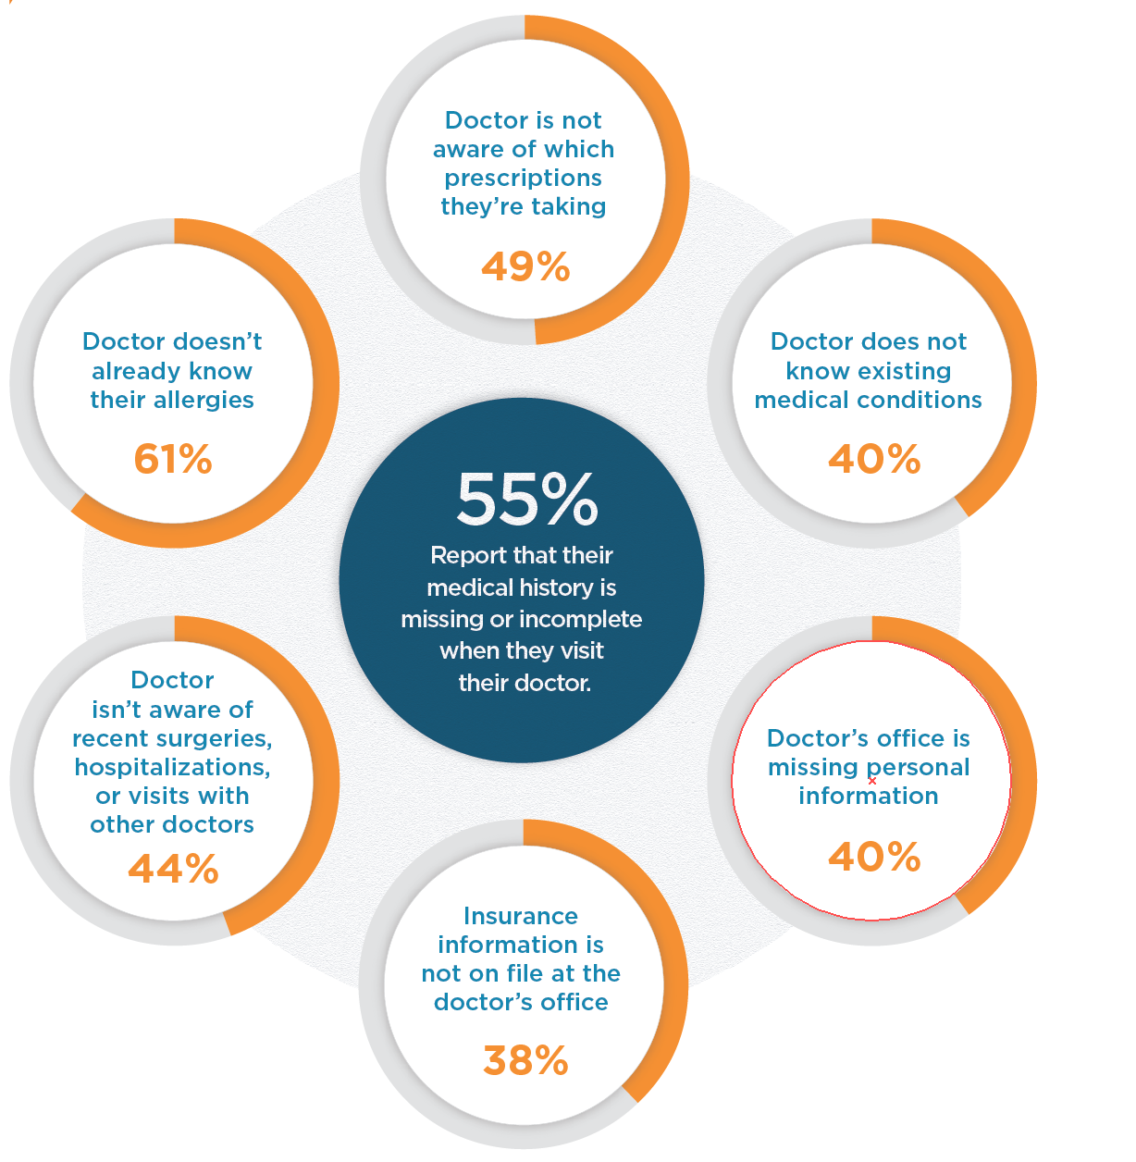
Connected Care and the Patient Experience, Surescripts, May 2015

Slide 13
As hospital margins decline
10,000 people a day become 65
inefficiencies become very visible
“Let patients help”
ePatient Dave

Slide 14
Care/operations: Efficiency
Record completeness
Visit preparedness
Patient generated data:
histories, medications, demographics
HIT of one
Self care/outcomes
Shared Decision Making
Exam efficiencies

Slide 15
How does your organization use patients to help with Efficiency?

Slide 16
Providers that do not make an effort to improve electronic health information sharing could lose patients to others that are more technologically advanced.
Connected Care and the Patient Experience, Surescripts, May 2015

Slide 17
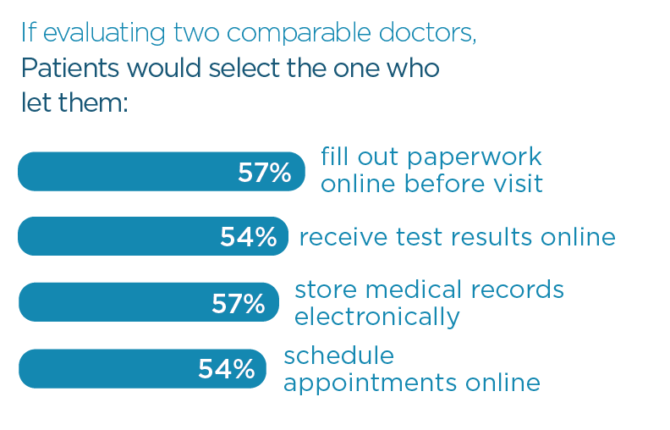
Connected Care and the Patient Experience, Surescripts, May 2015

Slide 18
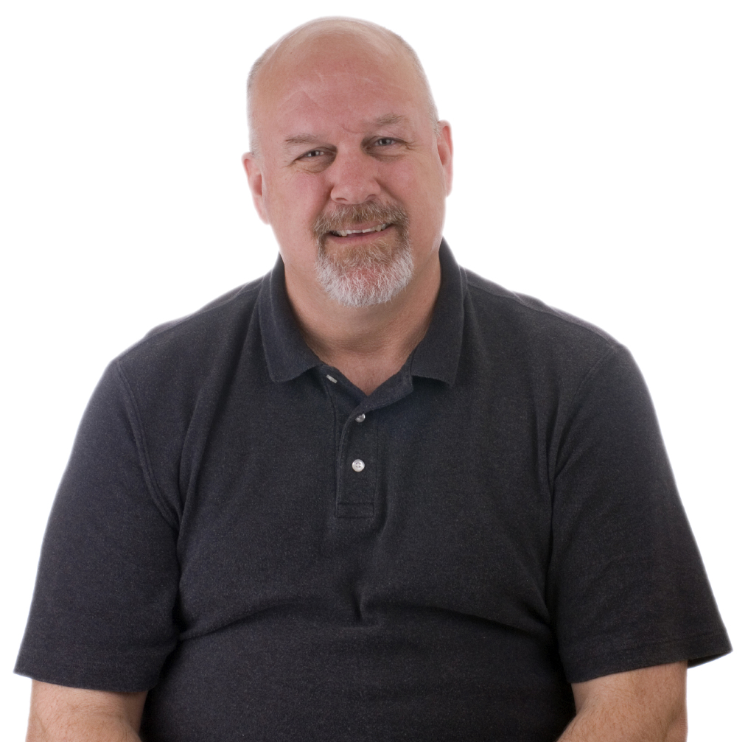
Engagement: Retention
Grow business
Remain in network
Relationship
Shared decision making:
Appropriate care
Training patients for future as efficient Medicare patients
Notes:
___________________________________________________________________________________________________________________________________________________________________________________________________________

Slide 19
How does your organization use patients to help with Retention?

Slide 20
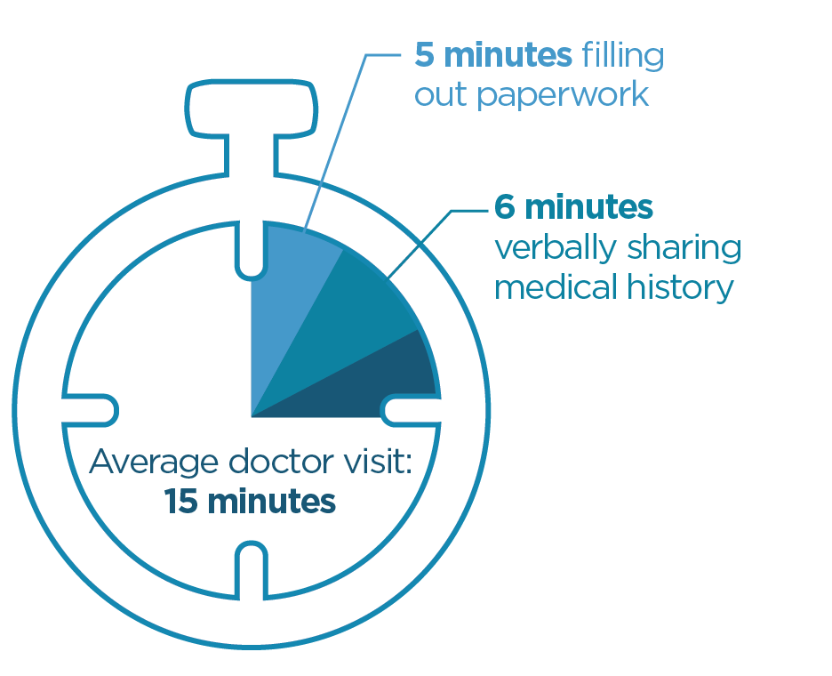
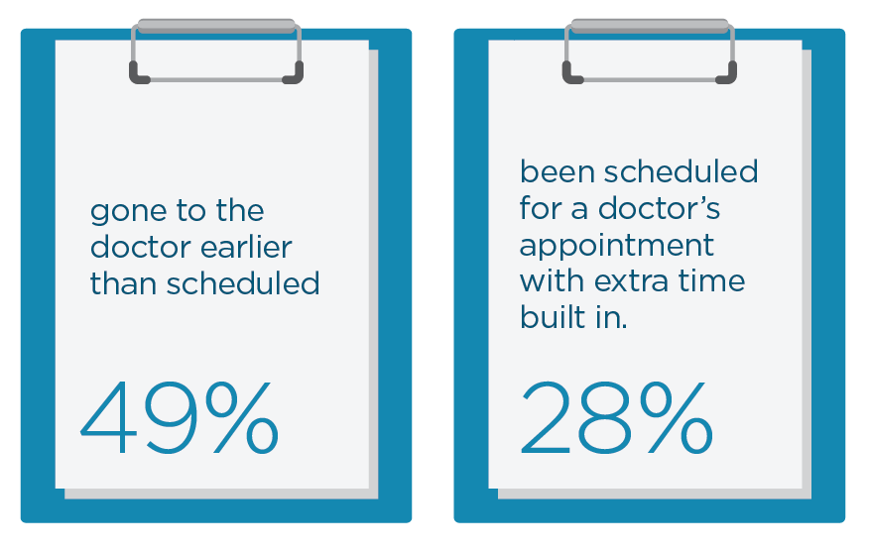
Patients are spending most of their doctor’s visit filling out paperwork or verbally telling the doctor their medical history
To deal with the paperwork required, many Americans admit they have:
Connected Care and the Patient Experience, Surescripts, May 2015

Slide 21
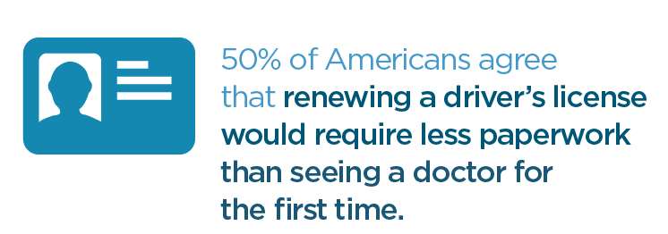
Unnecessary paperwork and phone calls make Americans dread visiting the doctor more than everyday tasks.
Connected Care and the Patient Experience, Surescripts, May 2015

Slide 22
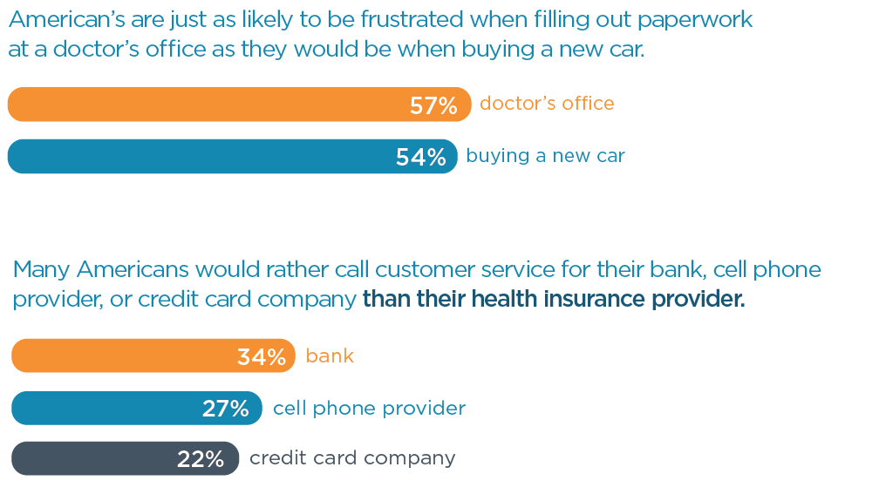
Connected Care and the Patient Experience, Surescripts, May 2015

Slide 23
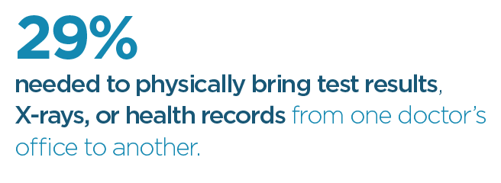
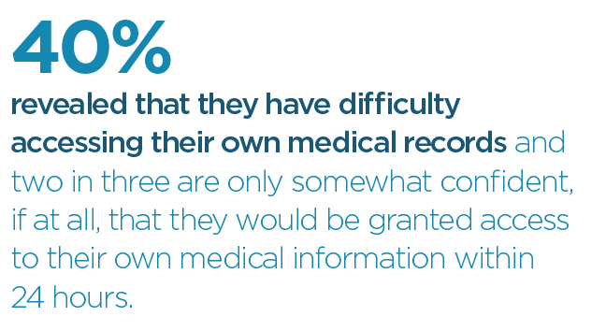
Patients are forced to take matters into their own hands:
Connected Care and the Patient Experience, Surescripts, May 2015
Notes:
___________________________________________________________________________________________________________________________________________________________________________________________________________

Slide 24
Family’s need: Convenience
Do not want status quo
Computer literate, smart phone enabled
Manage multiple generations
Often remotely
Dissatisfied with rigmarole of healthcare
Coordinate, prepare, communicate and save money and time
Notes:
___________________________________________________________________________________________________________________________________________________________________________________________________________

Slide 25
How does your organization use patients to help with Convenience?

Slide 26
A more digitally connected doctor would make millions of people more confident in their Doctor
Connected Care and the Patient Experience, Surescripts, May 2015

Slide 27
A more digitally connected doctor would make millions of people breathe a sigh of relief.
Connected Care and the Patient Experience, Surescripts, May 2015

Slide 28
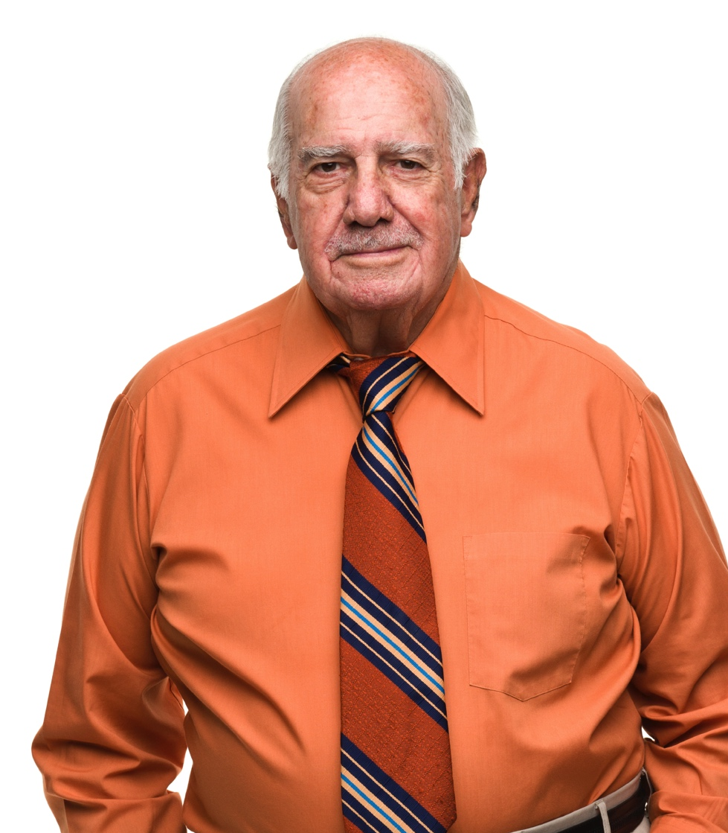
We all want: Empathy
Relationships matter
Care
Recruiting
Collaboration
Early warning system that can identify escalating care and intervene
A Data Book: Health care spending and the Medicare program, June 2014

Slide 29
How does your organization demonstrate Empathy? And use it to help in business?

Slide 30
Efficiency
Retention
Patient Engagement
Convenience
Empathy
Notes:
___________________________________________________________________________________________________________________________________________________________________________________________________________

Slide 31
Director, External Medical Communications Pfizer Medical
Vera Rulon, MS, RHIT, AHIMA Fellow, FACMIMIMI

Slide 32
Medication Mgt “Beyond the Pill”
eHI Business & Clinical Motivators
Vera Rulon MS, RHIT, FAHIMA
October 21, 2015

Slide 33
Medication Management
Pharma perspective on looking “Beyond the Pill”
Examples of Pfizer’s initiatives to help patients manage their health

Slide 34
Medication Management: The Data*
In the United States, some 3.8 billion prescriptions are written every year, yet over 50% of them are taken incorrectly or not at all.
Compared with patients who follow instructions, patients who don't take their medications as intended have a risk for hospitalization, re-hospitalization, and premature death that is 5.4 times higher if they have hypertension, 2.8 times higher if they have dyslipidemia, and 1.5 times higher if they have heart disease
Reasons that people site for not taking their medications include:
forgetfulness;
lack of knowledge about the medication and its use;
cultural, health, and/or religious beliefs about the medication;
denial or ambivalence regarding the state of their health;
financial challenges;
lack of health literacy; and
lack of social support.
*Chesanow, Neil “Why are so many patients non-compliant?” January 16th, 2015 http://www.medscape.com/viewarticle/818850_3

Slide 35
“Beyond the Pill” A holistic approach to drug development and therapy maintenance
Develop complementary interventions to improve patient outcomes
Create tools which may amplify the effectiveness of other interventions (or stand on their own)
Example: Obesity
Medicine does not work alone
Coaching programs only go so far
Put them together and you can realize a greater impact
Patient centricity: understanding unmet needs and motivators
Real world/Big data
Leveraging digital tools
Starting at the beginning: clinical trials

Slide 36
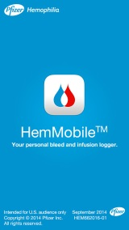
Patient Support Throughout the Patient Journey
Symptoms, Personal Preferences, Family history
Presentation & Evaluation
Diagnosis
Consideration of Treatment Options
Treatment Decision
Monitoring Therapy
Communicate Share Data
The New Healthcare Ecosystem
Patient / Caregiver Research
Shared Decision-Making

Slide 37
Questions?

Slide 38
Next steps
Join B&C listserv by contacting Claudia at Claudia.Ellison@ehidc.org
We will forward you the nomination email
Send out to any one you can think of as an innovator
Next Workgroup Meeting November 11

Slide 39
Thank you!

