Slide 1
eHealth Initiative Interoperability Work Group
January 19, 2016
2:00 p.m. EDT

Slide 2
Reminder
Please mute your line when not speaking
(* 6 to mute, *7 to unmute)
This call is being recorded

Slide 3
Agenda
Topic | Timeframe
Welcome and Overview | 2:00 p.m.
Planning for Privacy and Data Sharing Practices Project | 2:05 p.m.
Interoperability Repository | 2:45 p.m.
Next Steps | 2:55 p.m.

Slide 4
Data Sharing Practices Repository
Project Concept
Identify focus areas
Identify and collaborate with related projects
Define template for requesting information
Solicit examples of practices
Build on interoperability repository
2:05 -- 2:45

Slide 5
Data Sharing Practices Repository – Focus Areas
Hierarchy of consent management
How to manage the hierarchy and sharing across tiers
Approaches to 42CFR Part 2 – specificity is a challenge
Approaches to minors
Advance Directives
Managing patient preferences/multiple consent for a single individual
Health Home – Medicaid patient population management
Designation of entities and users
Cross jurisdiction
Cross HIE
2:05 -- 2:45

Slide 6
Data Sharing Practices Repository – Related Projects
Who else is addressing this challenge?
Commonwell – summary of care+++
Sequoia – eHealth Exchange, Carequality – these are around summary of care exchange
Medicity
Enables exchange with Federal Agencies
Direct Trust
Koble Group supported by Orion
How do we collaborate with these efforts?

Slide 7
Data Sharing Practices Repository – Template
Profile Element | Description
Responsible Entity | The owner of the project
Participating Entities | Types of organizations participating, e.g., hospital, provider
Description | Short description of the project
Standards Implemented | What standards were implemented in the project
Policies Adopted | What policies were implemented/adopted to support the implementation
Timeframe | Start date, key milestones
Volumes | Quantitative indicators, e.g., number of providers, number of records exchanged
Impacts | Quantitative results, e.g., reduction in delays, cost savings
 | Qualitative results, e.g., provider satisfaction, perceptions, testimonies
 | Challenges and how they were addressed
References | Links or attached documents
Contacts | Point of contact for further information
2:05 -- 2:45

Slide 8
Data Sharing Practices Repository – Solicit Examples
Outreach
eHI membership
Sequoia participants
Commonwell members
National Partnership for Women and Families
Center for Democracy and Technology
2:05 -- 2:45

Slide 9
Data Sharing Practices Repository – Build Repository
Use interoperability example repository as starting point
Additional requirements
2:05 -- 2:45

Slide 10
Data Sharing Practices Repository – Timelines
Task | Jan | Feb | Mar | Apr | May | Jun
Project Planning
Consult with Related Initiatives
Solicit Examples
Review Examples
Develop Repository
2:05 -- 2:45

Slide 11
Interoperability Repository
Soliciting additional examples
Maintaining content
2:45 -- 2:55

Slide 12
Next Steps for Interoperability Work Group
Reopen Work Group membership
Next call
Tuesday February 16
Monday February 15th is President’s Day
Should we change to the 3rd Tuesday of each month
Agenda
Project timeline
Feedback from related projects
2:55 – 3:00

Slide 13
Questions?

Slide 14
Thank you!

Slide 15
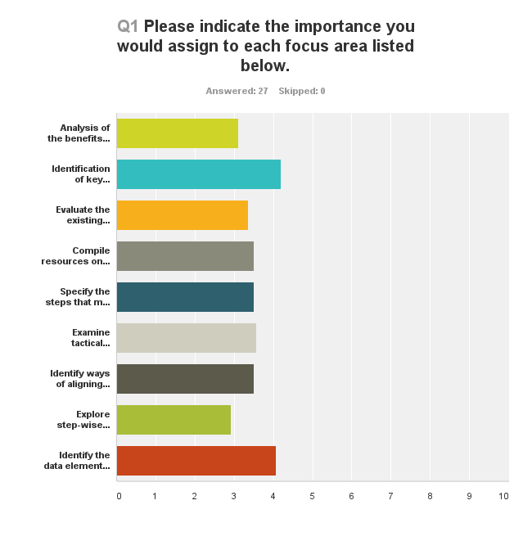
Focus Area Priorities
Challenges and Solutions
Privacy and Consent
Data Elements
Analysis of the benefits of interoperability and data sharing
Identification of key challenges to interoperability and data sharing and solutions that have been successfully implemented
Evaluate the existing infrastructure for exchanging health information to determine gaps and inefficiencies
Compile resources on state consent models and privacy laws to identify areas of commonality and discord
Specify the steps that must be taken to share information to understand what is working and where there are challenges
Examine tactical approaches to resolving state variation in privacy laws as it relates to interoperability
Identify ways of aligning existing regulatory approaches with non-regulatory approaches to influence creation of a health information exchange/interoperable healthcare ecosystem
Explore step-wise process to establish innovative private sector operational test processes, tools, harnesses
Identify the data elements that should be universally available
3.12
4.19
3.37
3.50
3.50
3.58
3.50
2.93
4.08
2:25 -- 2:45

Slide 16
Focus Area Comments
With respect to patient information safety and security and to ensure ongoing monitoring of compliance with HIPAA and other privacy measures, are there any current discussions/efforts to incorporate HIE standards into accrediting bodies such as JCAHO, ACHC, etc?
Identifying successful solutions that focus on patient and provider engagement will improve interoperability by better understanding those factors that motivate patients and providers to share information with each other despite the current barriers that exist. The stream of sharing that needs to be better understood involves provider to provider, provider to patient, and patient to provider information sharing.
Data standardization is one of our highest priorities. We have a monthly meeting with our major payers and two PPS's, as well as regular contact with our data sources. Jointly, we are discussing out to reach out to practices to educate them too.
continued collection of examples of interoperability successes costs of ensuring interoperability capabilities IT requirements additional documented (and anecdotal) examples
I think the benefits are being covered in the Clinical Motivators workgroup. The key challenges/solutions is very similar to what we just did in this recent report. Perhaps we could clarify where/how the different exchange standards/approaches being worked on should be used (CCDA, FHIR, Commonwell, eHealth Exchange, Epic CareEverywhere, etc). No one of them is sufficient on its own to solve the interoperability problem even though each may promote itself that it is. We could help clarify the strengths/weaknesses and appropriate/inappropriate use cases for each to help the industry get past the hype and understand how to use them.
2:25 -- 2:45

Slide 17
Focus Area Comments
We are currently working to compare the ambulatory CCDs and CCDAs that our HIE is receiving for gaps in data; if the data is not on the document due to 1) not captured during the encounter, 2) workflow at practice or 3) how the vendor set up the rules around data pulled to the document. We have multiple practices on eCWorks, Allscripts, and Athena, we will complete an analysis across unaffiliated practices. We also have two eCW HUBS that support multiple affiliated practices, we can look at the variance that may be due to practice workflow and data capture. What we have found so far is that the "table of contents" on the front of the document is in no standard order. It may prove helpful to the clinician if the list had a standard order - ie. problems list, then medications, then allergies, etc. The table of contents only includes data elements found on the document, but it's difficult to confirm at a quick glance what is in the document which can be 3 pages or 42 pages. We will share findings of our gap analysis with eHealth, HIMSS and other interested organizations.
I ranked every option "very low" save for one above because the wording of each reveals a mindset that accepts the status quo and proposes, in one way or another, to study it. To my mind the best thing this group could do is take a sober and honest look at the real-world impediments to interoperability in healthcare, shine a bright light on those, and give some publicity to successful efforts to circumvent those impediments. That has the potential to move the needle in a meaningful way.
Over the past several years the nation has battled to achieve National Interoperability, are the efforts currently underway and being spoken about demonstrate that a focus on Regional Interoperability is more in line with current Healthcare needs. Could the focus on National Interoperability be distracting us from the immediate needs (the highest patient care requirements - are select segment of the population) - with patients at the center of the care-circle - solutions need to focus on Regional Interoperability, Care Teams ability to coordinate (which may lay outside a single organization) workflow, Access Consent (controlled sharing of clinical information) across the care continuum. The challenge here is no-one vendors can provide a solution, the industry must work together with regulators, and standards bodies. We need to see the larger mission of patient first, patient focus initiatives - Interoperability at the patient level does matter - Until then, we will keep getting lost with National initiatives (such as the ones like ONC publishes), but which many Regional initiatives don't bother with and are not focused on. Who is doing Interoperability it right?
2:25 -- 2:45

